Slide 1
Graphs and Social Networks
Roshni Iyer
CS Department
UCLA
roshnigiyer@cs.ucla.edu
Debarnab Mita
ECE Department
UCLA
debarnabucla@ucla.edu
Swapnil Sayan Saha
ECE Department
UCLA
swapnilsayan@g.ucla.edu
July 2021
Note: Slides adapted from original LACC slides from Dr. Luis Garcia & Saptadeep Pal
Some materials adapted from UCLA ECE 232E course by Prof. Vwani Roychowdhury

Slide 2

Instructors
Roshni Iyer
Vice President, CS-GSA
CS PhD student @ UCLA
& CS Major from UC Berkeley
Graduate Researcher, ScAi Lab @ UCLA
Research Interests:
Graph neural networks, knowledge graphs
for various applications
Notes:
This slice shows the content structure of this lecture.

Slide 3

Instructors
Swapnil Sayan Saha
ECE PhD @ UCLA,
ECE MS from UCLA
EEE Major from UofDhaka
GSR @ NESL, UCLA
Entering Event’s Director, EGSA
Research Interests:
Applied AI, Embedded Systems
Notes:
This slice shows the content structure of this lecture.

Slide 4

Instructors
Debarnab Mitra
ECE PhD @ UCLA,
ECE MS from UCLA
EE Major from IIT Bombay
GSR @ LORIS, UCLA
Research Interests:
Coding Theory, Blockchains
Notes:
This slice shows the content structure of this lecture.

Slide 5

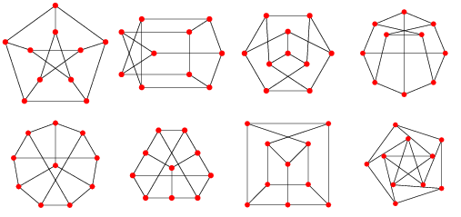
In This Lecture…
We are going to:
Introduce the concepts of a social network and graph theory
Play ‘Six Degrees of Kevin Bacon’
Learn some basic graph theory
Then we will do programming exercises:
Easier: some simple graph theory
Harder: path and cycle detection
find connected components
Notes:
This slice shows the content structure of this lecture.

Slide 6
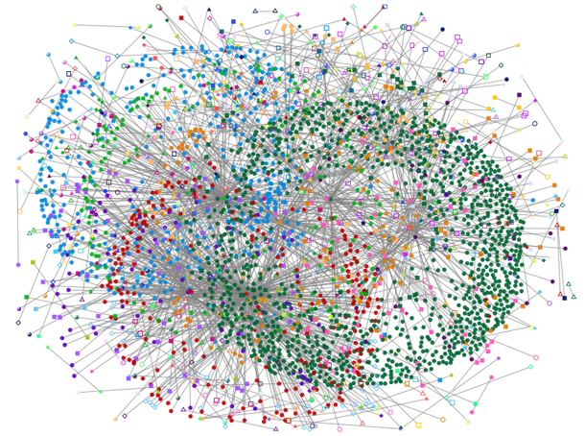

Social Networks
Q: What’s a social network?
A: It is a structure made up of individuals (or organizations, or agents, or anything else) tied together by relations or connections – such as friendship, alliance, financial or common interest, etc…
Q: Why should we study social networks?
It’s useful! Tons of applications:
Finding friends and matchmaking .
Locating appropriate customers for
companies (marketing).
Preventing spreading of diseases in epidemics…

Slide 7
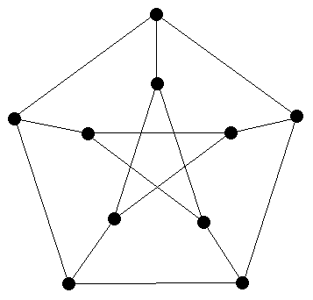
Graph Theory
The main tool used to understand social networks is graph theory.
An example of a graph:
Petersen graph

Slide 8
Graph Theory
A graph is made up of nodes (also called vertices) and edges:
Which are the nodes and which are the edges in the graph below?
Petersen graph

Slide 9
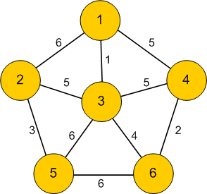
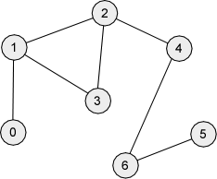
Graph Theory
• Edges can be weighted or unweighted (= uniformly weighted graph).
Weights: allow us to express the importance of a connection.
Q: Can you think of some applications where we need edge weights?

Slide 10
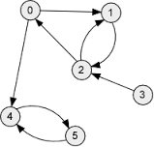
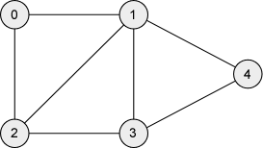
Graph Theory
• Edges can be directed or undirected.
Directions allow us to have influence go one way (rather than mutual).
The type of graph we use is dependent on

Slide 11
Example of directed edges in a graph
Rock – Paper – Scissor Game
rock
rock
covers
crushes
paper
scissor
paper
scissor
cuts

Slide 12
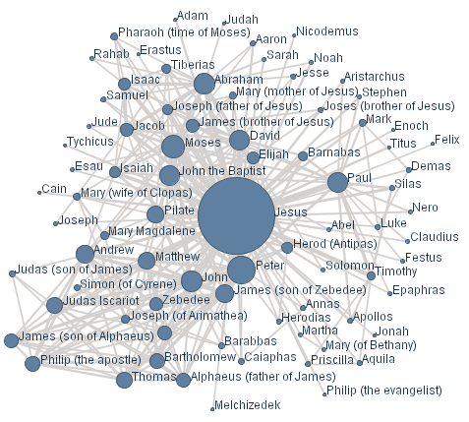
Graph Theory
Q: Why do we care about graphs?
A: We can use them to represent a social network:

Slide 13
Acting Networks
A good example of a network is formed by our coworkers, their coworkers, etc…
We’ll look at Hollywood actors.
We’ll say that two actors are connected if they played in the same film.

Slide 14
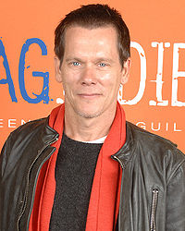
Kevin Bacon
Q: Who is the “center” of the movie universe?
A: Kevin Bacon. Have you heard of him? If not – it’s because he’s known for playing a supporting role in a huge number of films:
Kevin Bacon

Slide 15
Kevin Bacon
We can play a game called ‘Six Degrees of Kevin Bacon.’
The rules:
Pick an actor or an actress.
If they have played in a film with Kevin Bacon, their Bacon number is 1.
If they have played in a film with someone with a Bacon number of 1, they have a Bacon number of 2.
Etc…
Example: Bradley Cooper:
Bradley Cooper was in “Silver Linings Playbook” (2012) with Jennifer Lawrence.
Jennifer Lawrence was in “X-Men: First Class” (2011) with Kevin Bacon.
So Bradley Cooper has a Bacon number of 2.

Slide 16
“Six Degrees” Game
Exercise:
Using IMDB, find the Bacon number (and path) for:
Julia Roberts
Selena Gomez
Christian Bale

Slide 17
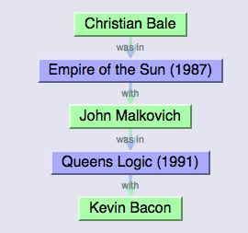
“Six Degrees” Game
It’s a lot easier with an automated tool that searches IMDB:
http://oracleofbacon.org/cgi-bin/movielinks
For example, it produces this output for Christian Bale:

Slide 18
“Six Degrees” Game
Exercise: Try out the Oracle tool with your favorite actors.
What’s the largest Bacon number you can get?

Slide 19
“Six Degrees” Game
We saw a lot of actors with Bacon numbers 1 and 2.
What about the extremes?
What’s the smallest possible Bacon number? Who has it?
What’s the largest possible Bacon number?
What if someone is not connected to Kevin Bacon at all?
Among those who are, what’s the largest Bacon number?

Slide 20
“Six Degrees” Theorem
The “Six Degrees” idea states that any two people selected at random are connected by at most 6 degrees.
Of course, there are some counterexamples, but they’re rare.
Same applies to Hollywood – which is why the game is called “Six Degrees of Kevin Bacon.”

Slide 21
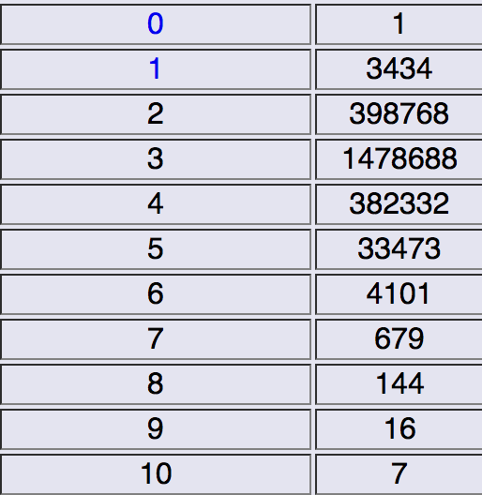
Back to Kevin Bacon
Here’s a statistic about Kevin Bacon numbers for other actors:
Bacon Number # of People

Slide 22
Back to Kevin Bacon
What can we see from the table?
Most people have a Bacon number of 3.
Slightly less have a Bacon number of 2 and 4.
Bacon numbers higher than 4 are rare.
The maximum is 10.

Slide 23
Back to Kevin Bacon
You can replace Bacon with other actors to see who makes a good “center” for connections.
Try it out:
http://oracleofbacon.org/cgi-bin/center-cgi

Slide 24
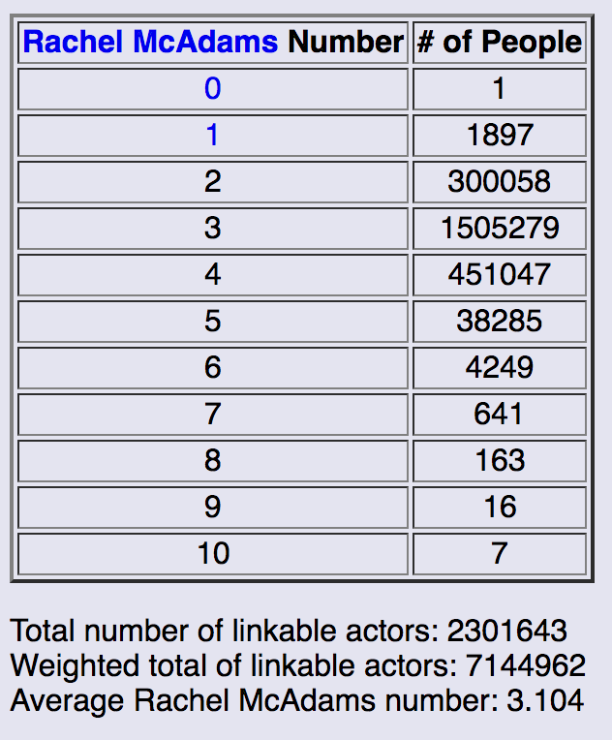
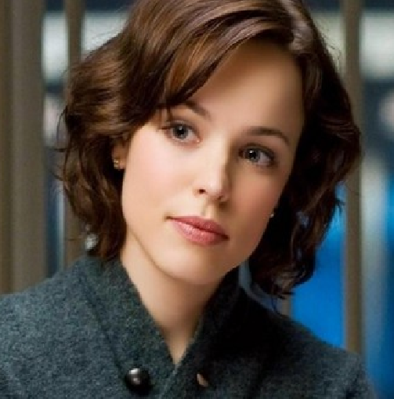
Back to Kevin Bacon
What does it mean to be a good “center?”
For example, we see that Tom Cruise has an average number of 2.976 while Bacon has an average of 3.026. Who’s better?
Exercise: Try out your favorite actor. Who picked the best center?

Slide 25
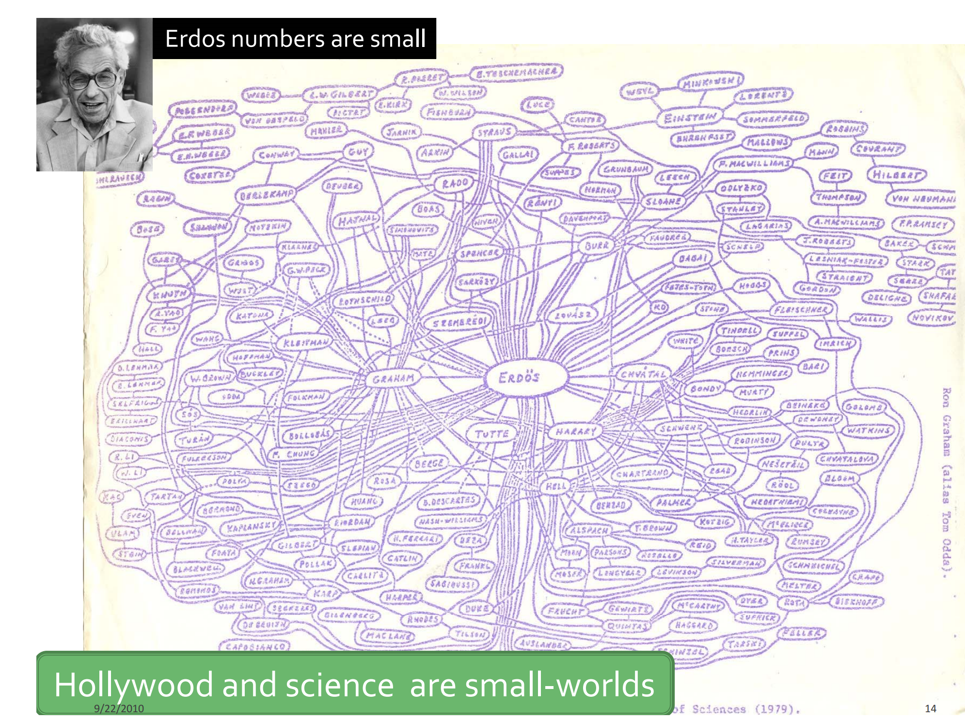
What about the world of science?
Erdős numbers:

Slide 26
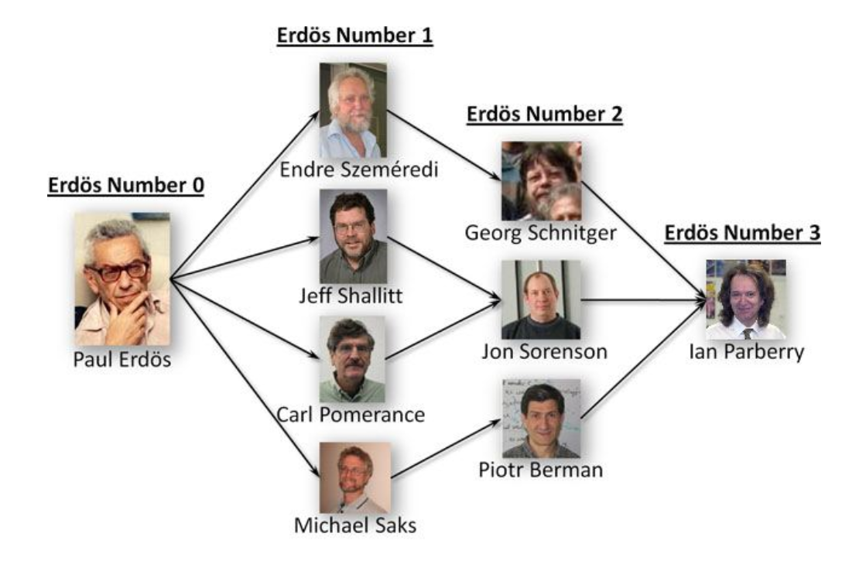
Erdős numbers
Describes the "collaborative distance" between mathematician Paul Erdős and another person, as measured by authorship of mathematical papers.

Slide 27
What’s your Erdos number?
Roshni Iyer (instructor of this module): 2
Paul Erdős
Satish Rao
Roshni Iyer
Compute: https://oakland.edu/enp/compute/

Slide 28
Larger networks
We saw, from the Kevin Bacon game, that
1. Hollywood has about 1 million actors.
2. Most of them can be related to each other within 4 connections.
What about all the people in the US?
Population is about 300 million.
Q: About how many connections on average between two random people?
(Note: define connection here as “being acquainted with.”)

Slide 29
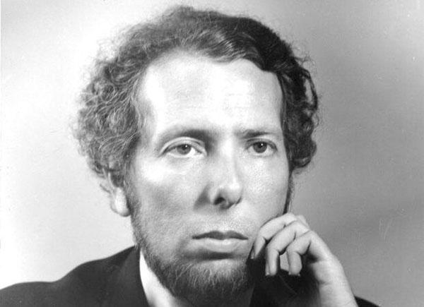
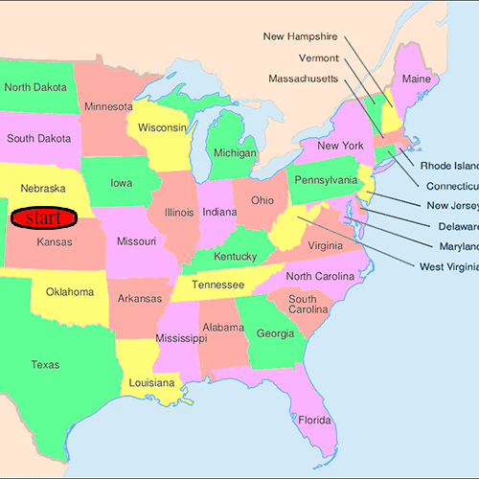
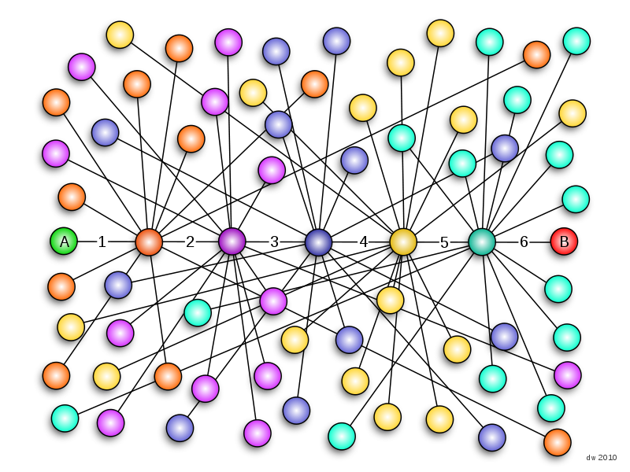
Larger Networks
“Six Degrees” Theorem still applies!
So, if we pick two random people in the US, using a chain of “friends of friends”, we should be able to connect them within 6 connections.
Studied by the famous psychologist Stanley Milgram in his “Small world experiment” in the 1960’s.
Easily recreated today using Facebook!
Stanley Milgram

Slide 30
“Six degrees” Theorem
So what’s useful about it? Applications?
One example: Insurance companies request customers to provide 5 referrals in order to expand their business.
Exercise: Come up with another example.

Slide 31
Graph Theory
We’ve talked about networks, connections, “distances”, etc…
Now it’s time to describe the math behind this.
This domain is called “graph theory.”

Slide 32
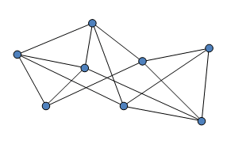
Graphs
A graph is made up of “nodes” and “edges.”
Nodes are denoted by a dot/vertex.
Edges connect two nodes.
If two nodes have an edge between them, they are “adjacent” or “neighbors.”

Slide 33
Degrees
The number of edges coming out of a node is called its “degree.”
Sometimes degree is specified to be out-degree (outgoing edges) or in-degree (incoming edges).
What are the in-degrees & out-degrees of the nodes in the graph below?
All nodes have same degree: regular graph. If not, irregular.
Q: Are complete graphs (maximally connected graphs) regular or irregular?

Slide 34
Degrees
What’s the relationship between vertex degrees and edges?
Exercise: Give the relationship described above.
(hint: think about the sum of all the degrees and the number of edges.)

Slide 35
Idea
Enumerate ordered pairs (i,j) in the graph, where i and j is connected by an edge.
Count by vertices:
If node i has degree di, then there are di ordered pairs of of (i,j)
The number of ordered pairs=sum of degrees of all nodes
Count by edges:
If (i,j) is an edge, then both (i,j) and (j,i) are ordered pairs
The number of ordered pairs=2 times number of edges
Sum of degrees of all nodes=2 times number of edges

Slide 36
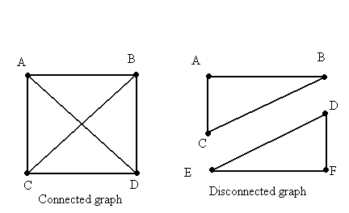
Connectivity
A series of edges is called a “path.”
If there exists a path between two nodes, the two nodes are “connected.”
If every pair of nodes in a graph is connected, the entire graph is “connected”, otherwise it is “disconnected”.
A disconnected graph can be divided into multiple connected components
Connected graph has only 1 connected component

Slide 37
How to find the shortest path between two nodes?

Slide 38
How to find the shortest path between two nodes?

Slide 39
How to find the shortest path between two nodes?

Slide 40
How to find the shortest path between two nodes?

Slide 41
How to find the shortest path between two nodes?

Slide 42
How to find the shortest path between two nodes?

Slide 43
How to find the shortest path between two nodes?

Slide 44
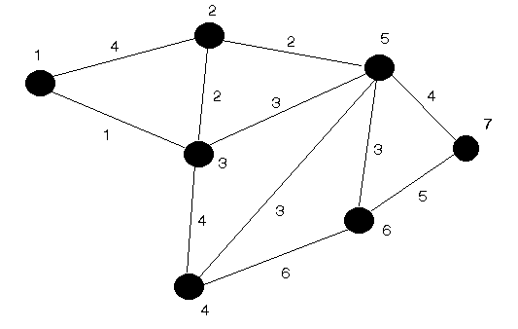
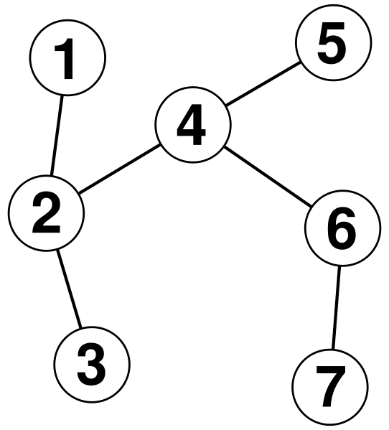
Cycles
A series of edges (a path) starting and ending in the same node is called a “cycle.”
Q: Which graphs have cycles? If so, how many cycles are there?

Slide 45
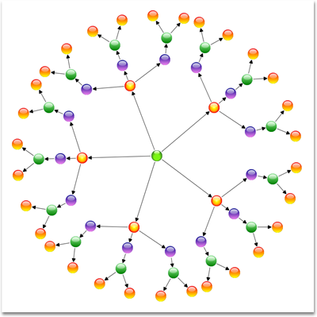
Trees
A connected graph with no cycles is called a “tree”.
If we remove “connected” from this definition, the graph will be called a “forest”.
Exercise: If we have a tree with n nodes, how many edges will it have?
(hint: draw some small examples of trees and see what you get.)

Slide 46
Idea
Leaves in a tree: a node with degree 1 is called a leaf of the tree
Every tree has at least two leaves

Slide 47
Idea
Leaves in a tree: a node with degree 1 is called a leaf of the tree
Every tree has at least two leaves

Slide 48
Idea
Leaves in a tree: a node with degree 1 is called a leaf of the tree
Every tree has at least two leaves

Slide 49
Idea
Leaves in a tree: a node with degree 1 is called a leaf of the tree
Every tree has at least two leaves
Remove leaves and its connected edges will not change the difference between the number of nodes and the number of edges

Slide 50
Idea
Leaves in a tree: a node with degree 1 is called a leaf of the tree
Every tree has at least two leaves
Remove leaves and its connected edges will not change the difference between the number of nodes and the number of edges

Slide 51
Idea
Leaves in a tree: a node with degree 1 is called a leaf of the tree
Every tree has at least two leaves
Remove leaves and its connected edges will not change the difference between the number of nodes and the number of edges
Kept removing leaves from the tree, we finally obtain a graph of a single node
#nodes-#edges=1 in a tree
Notes:
Roshni - up to here

Slide 52
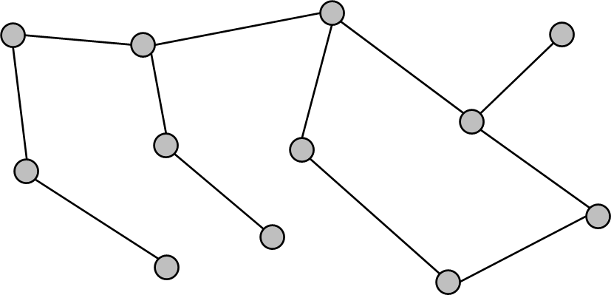
How to find a cycle in a graph?

Slide 53
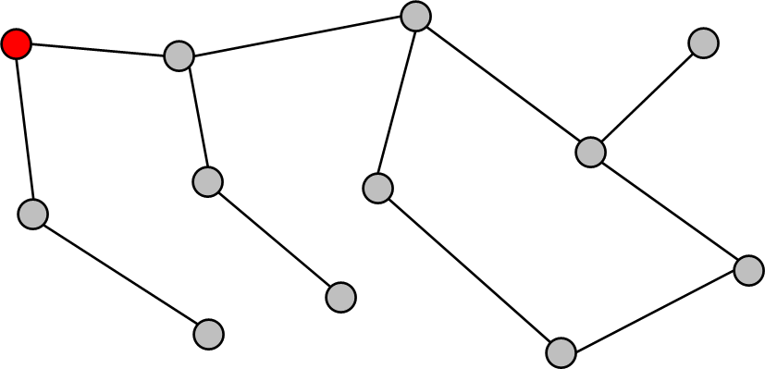
How to find a cycle in a graph?

Slide 54
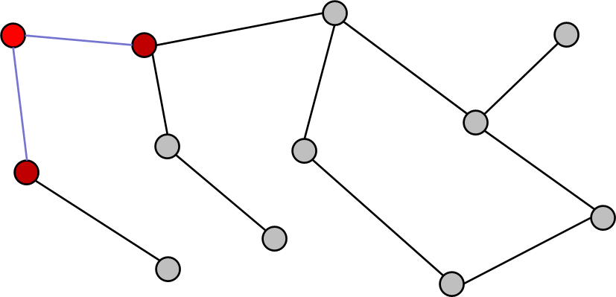
How to find a cycle in a graph?

Slide 55
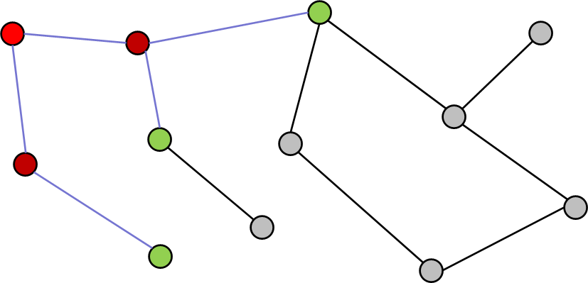
How to find a cycle in a graph?

Slide 56
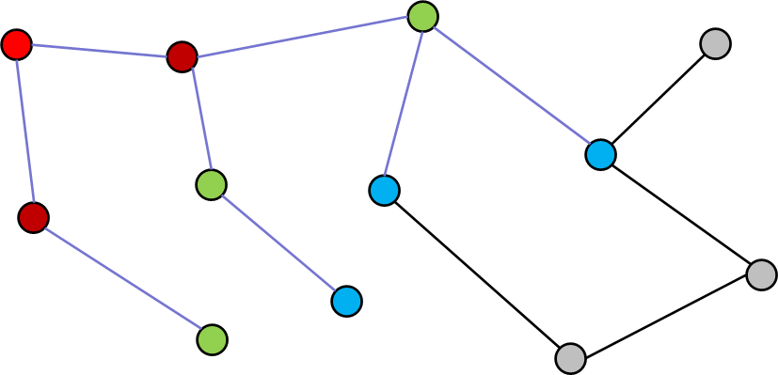
How to find a cycle in a graph?

Slide 57
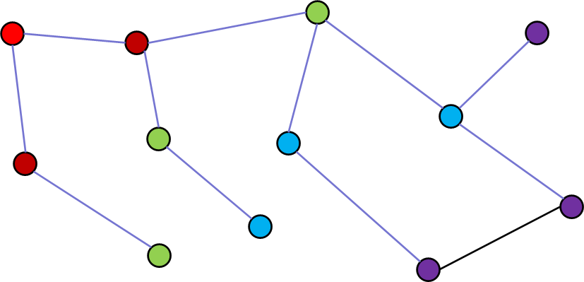
How to find a cycle in a graph?

Slide 58
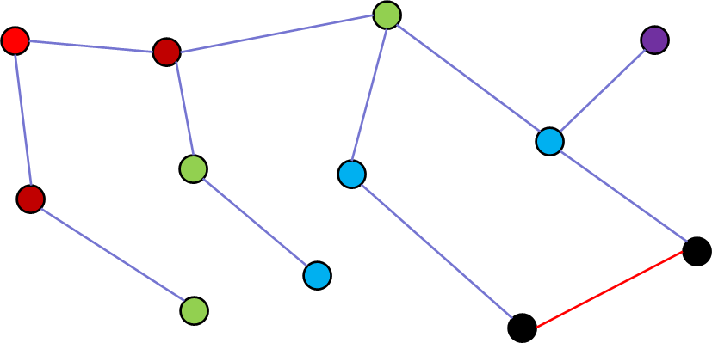
How to find a cycle in a graph?

Slide 59
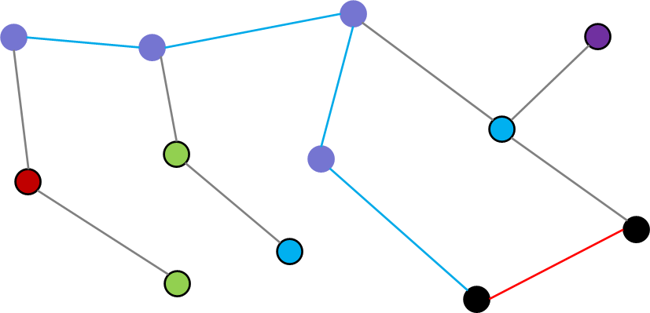
How to find a cycle in a graph?

Slide 60
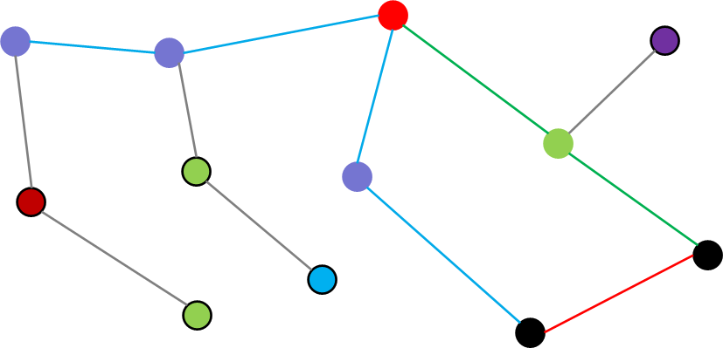
How to find a cycle in a graph?

Slide 61
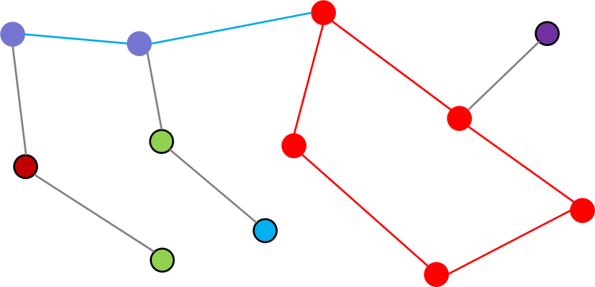
How to find a cycle in a graph?
Notes:
basically trying to follow all paths until you reach the black node again

Slide 62
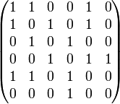
Adjacency Matrix
When we can’t draw a graph, we can represent it with a matrix.
If row i, column j contains a 1, there is an edge between nodes i and j. If there’s a 0, there’s no edge.
Exercise: Draw the graph for this adjacency matrix. What’s the degree of each node? Is there something special about node 1? Are there any cycles? What are their lengths?

Slide 63
Adjacency Matrix
2
1
3
4
6
5

Slide 64
Adjacency Matrix
2
1
3
4
6
5

Slide 65
Adjacency Matrix
2
1
3
4
6
5

Slide 66
Adjacency Matrix
2
1
3
4
6
5

Slide 67
Adjacency Matrix
2
1
3
4
6
5

Slide 68
Adjacency Matrix
2
1
3
4
6
5
Exercise:
What’s the degree of each node? How is it related to the adjacency matrix?
Is there something special about node 1?
Are there any cycles? What are their lengths?
Is the Adjacency matrix of a graph symmetric?

Slide 69
Further topics:
Social Network:
Social Network Visualization
http://www.science.smith.edu/dftwiki/index.php/Visualizations:_Social_Networks
Classical Graph Theoretical Problems:
Seven Bridges of Konigsberg
Traveling Salesman Problem
Four Color Theorem
Algorithms on graphs
What’s more?
Algebraic graph theory: Complexity theory
Extremal graph theory: Cryptography, Coding theory
Random graph theory: Social networks, Network navigation
Machine learning

Slide 70
Exercise 1: Easy graph theory
First, take a look at matrix.txt
It’s an adjacency matrix
Now, look at graphs.py
All we’ll do is implement two simple functions:
matrix_load() reads the matrix.txt file and loads it into a matrix (an array of arrays)
print_degrees() prints the degrees of each node
Comments / hints are provided above each function.
Optional: is_connected() returns 1 if the graph is connected, 0 otherwise.

Slide 71
Mini-Project: Shortest Path
Next we’ll do something harder.
Implement a function that finds the shortest path between arbitrarily two nodes:
def shortest_path (mat,node1,node2)
Print out ‘No such path’ and return [] if node1 and node2 are not connected
Print out the shortest path by the edges on the path and return a list containing the nodes on the graph otherwise.
It’s not obvious how to do this at first – try out some ideas on paper, then code it up only when you have a working algorithm that you can do manually.
Generate multiple random graphs to test on your program

Slide 72
Mini-Project: Cycle Detection
Next we’ll do something harder.
Implement a function that detects whether or not there is a cycle in the graph. The definition will be:
def detect_cycle(mat)
Print out an arbitrary edge on the cycle and return a list containing all nodes on the cycle if there is one
Print out ‘No cycle in the graph’ and return [] otherwise
In the first step, assume the graph is connected and solve the problem.
Generate multiple graphs to test on your program
Question: Does it make any difference if the graph is directed?

Slide 73
Mini-Project: Cycle Detection for General Graphs
Next we’ll do something harder.
Bonus: solve it for more general graphs that contain multiple connected components
The definition will be:
def detect_cycle_gen(mat)
The requirements are specified in CycleGen_E.py
Generate multiple graphs to test on your program
Question: Does it make any difference if the graph is directed?

Slide 74
Mini-Project: Preliminaries
Things you might need in Python:
Lists
Suppose A is a list
A.append(x) appends x to A
The expression (x in A) returns True if A contains x, otherwise it returns False
A[n] returns the (n+1)-th element of A
The elements of a list could also be lists
A=[2,3,[4,5],6,[7,[8,9]]
A[0]=2,A[1]=3,A[2]=[4,5],A[3]=6,A[4]=[7,[8,9]]
A[2][0]=4,A[2][1]=5
A[4][0]=7,A[4][1]=[8,9]
A[4][1][0]=8,A[4][1][1]=9
Reading files
Filename “matrix.txt”
Fh=open(“matrix.txt”)
A=Fh.readlines() will return a list containing all the lines of the file

Slide 75
Mini-Project: Preliminaries
Things you might need in Python:
Reading files
Filename “B.txt”
Fh=open(“B.txt”)
A=Fh.readlines() will return a list containing all the lines of the file
Example
If the file “B.txt” contains the following text:
Hello world!
010001
Python
Then A=[‘Hello world!’, ‘010001’, ‘Python’]
Each component of A is a string

Slide 76
References
Graphs: http://people.brunel.ac.uk/~mastjjb/jeb/or/graph.html
Graph Theory: http://en.wikipedia.org/wiki/Graph_theory
Kevin Bacon: http://oracleofbacon.org/

Slide 77
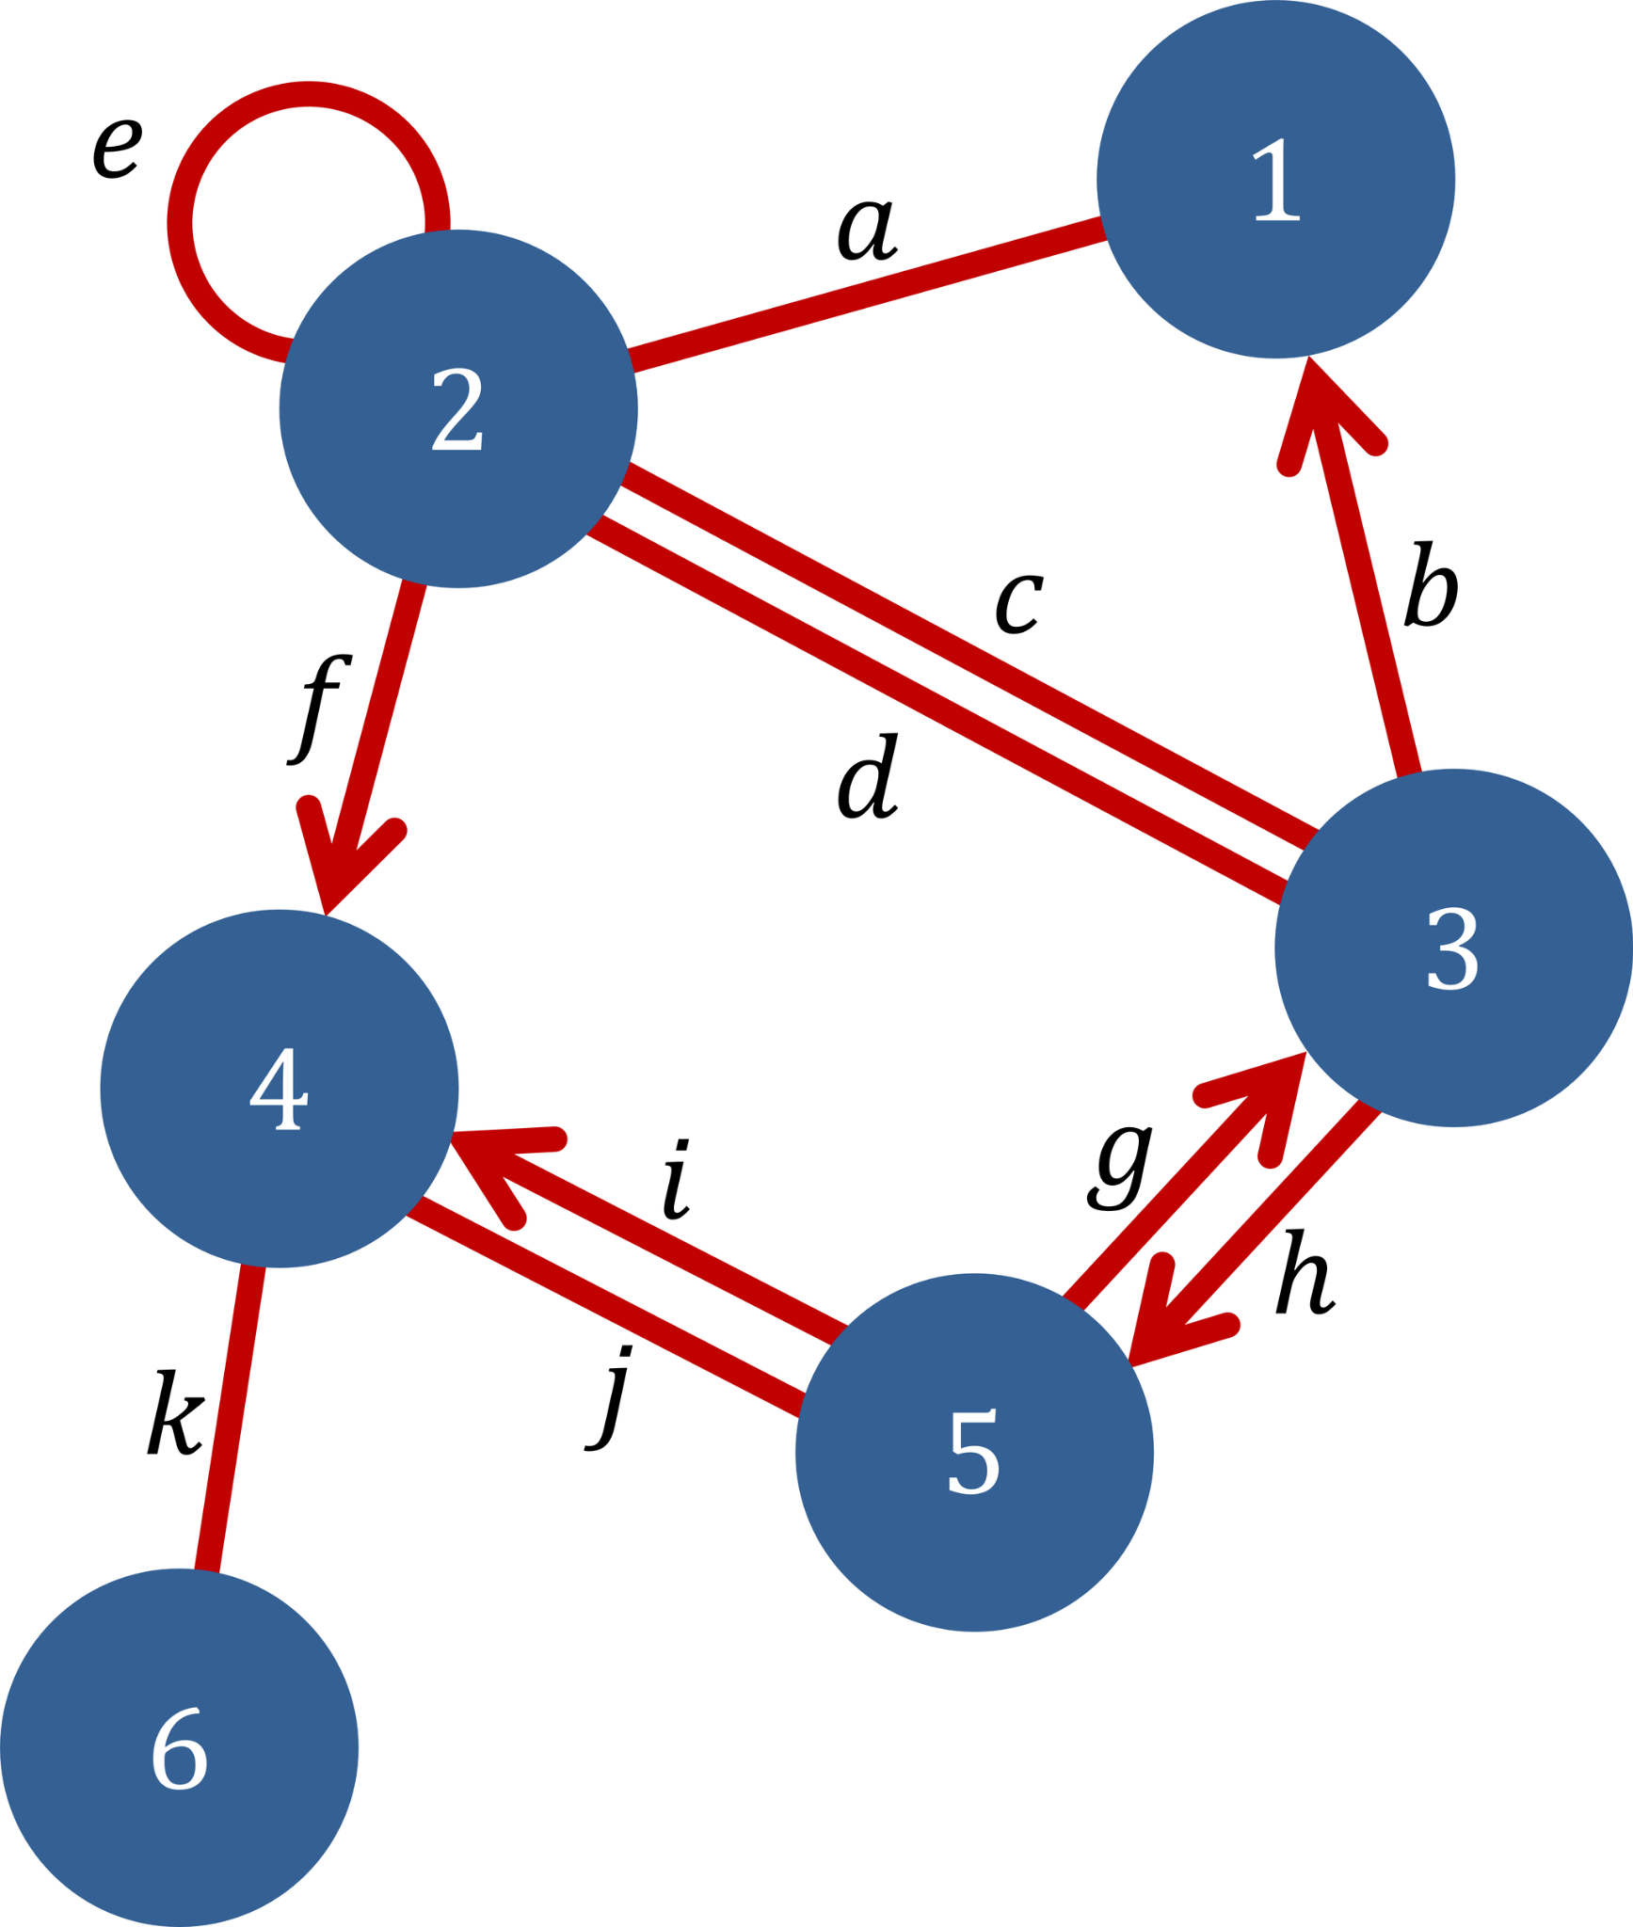
Quick Recap
Last day, we learnt about:
Graphs: Vertices, Edges, Weights, Directivity
Degree, Connectivity
Shortest Path, Cycles, Tree
Adjacency Matrix
Notes:
This slice shows the content structure of this lecture.

Slide 78
Contents
Common random graphs:
Barabasi-Albert Networks with Preferential Attachment
Erdos-Renyi Networks
Community Structures and Modularity
Minimum Spanning Tree (MST)
Shortest Path: Dijkstra's Algorithm
Traveling Salesman Problem (TSP)
Notes:
This slice shows the content structure of this lecture.

Slide 79

Preferential attachment
Popular nodes act as bridge between unpopular nodes.
The more popular a node, the higher is the probability for it to be connected to incoming nodes.
Popularity is measured by the degree of a node.
The Barabasi-Albert model creates scale-free, evolving and connected networks with preferential attachment.
The degree distribution of such networks follow power-law.

Slide 80
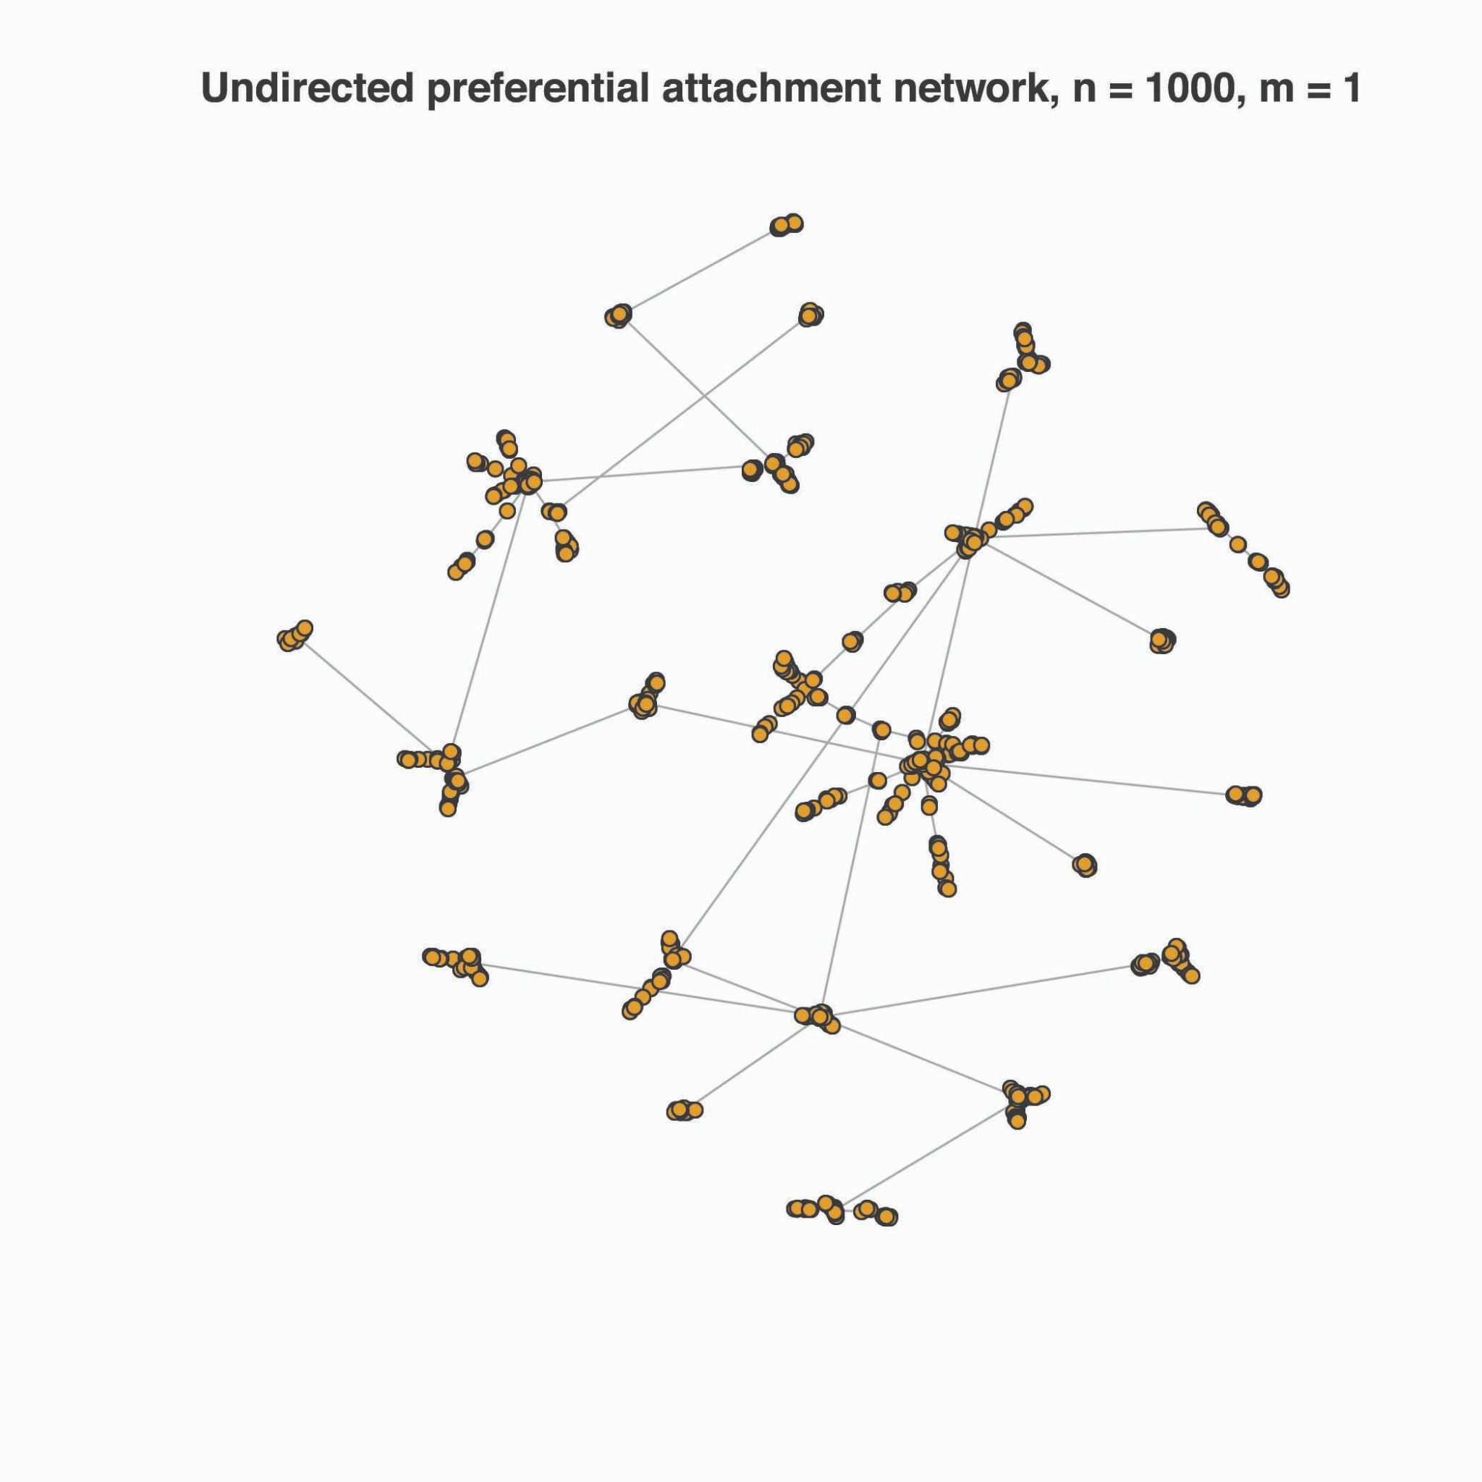
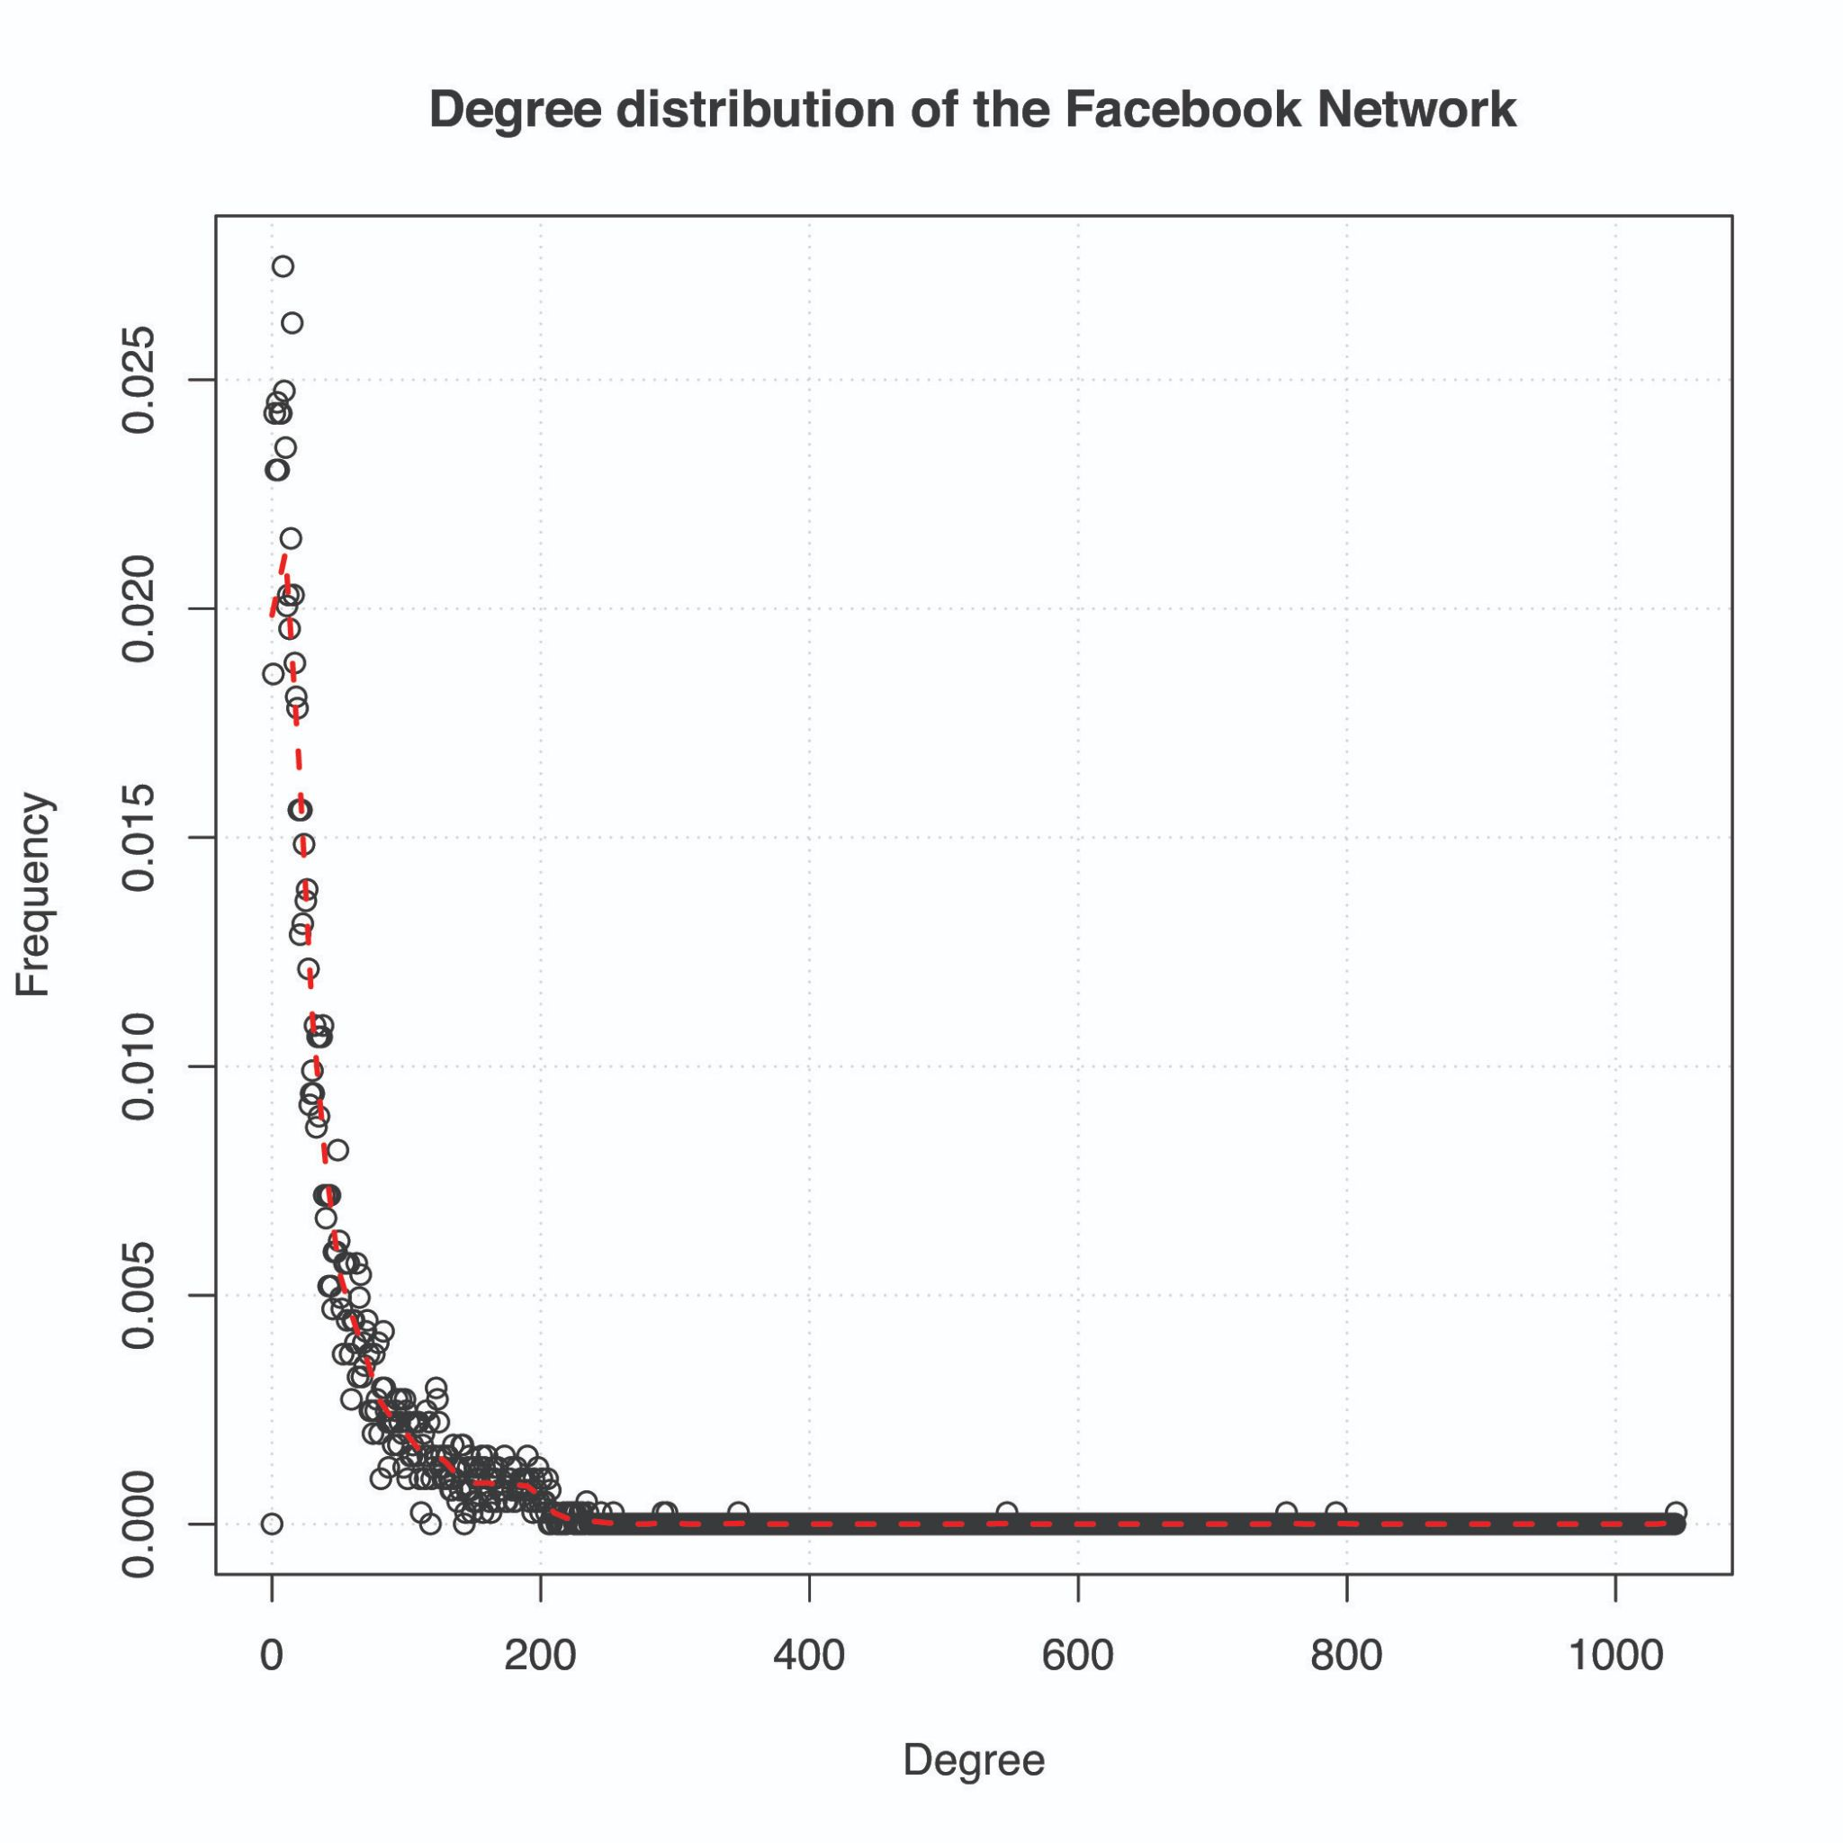
Preferential attachment

Slide 81
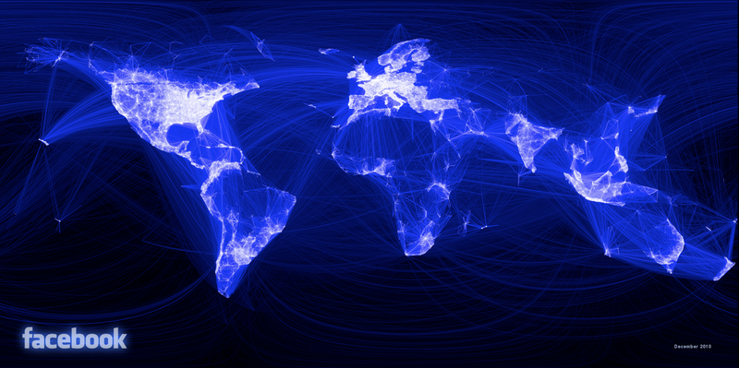
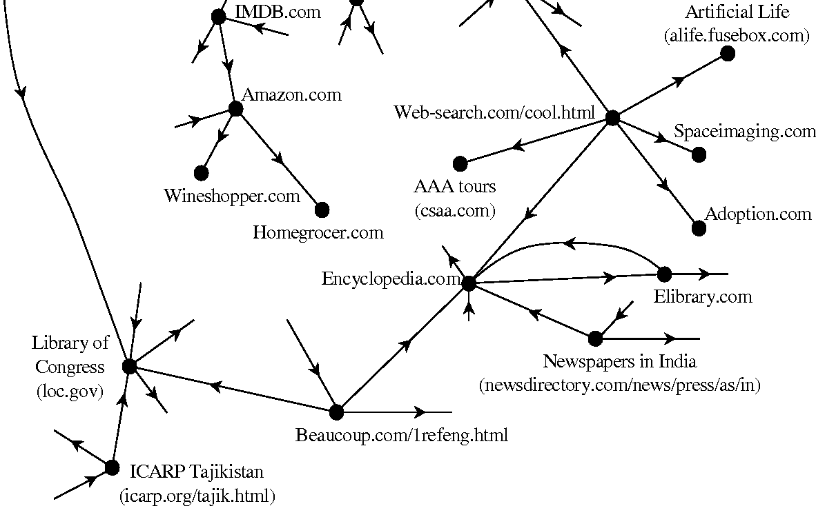
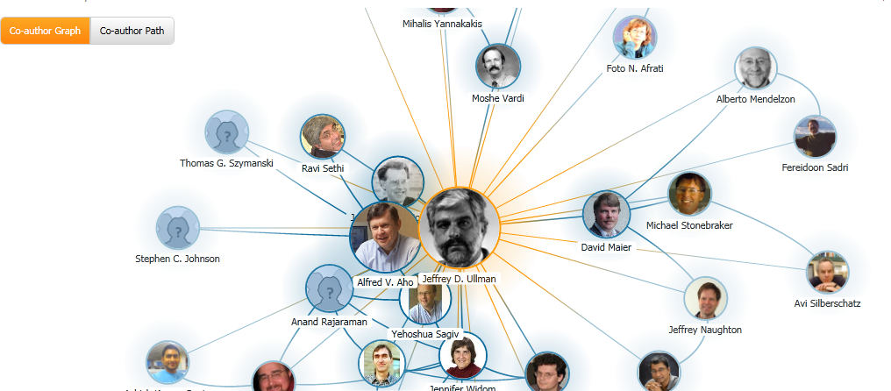
Applications
Social Networks
Search engines (PageRank)
World Wide Web
Citations among researchers
Internet
Recommendation Systems
Family / Erdos Trees

Slide 82
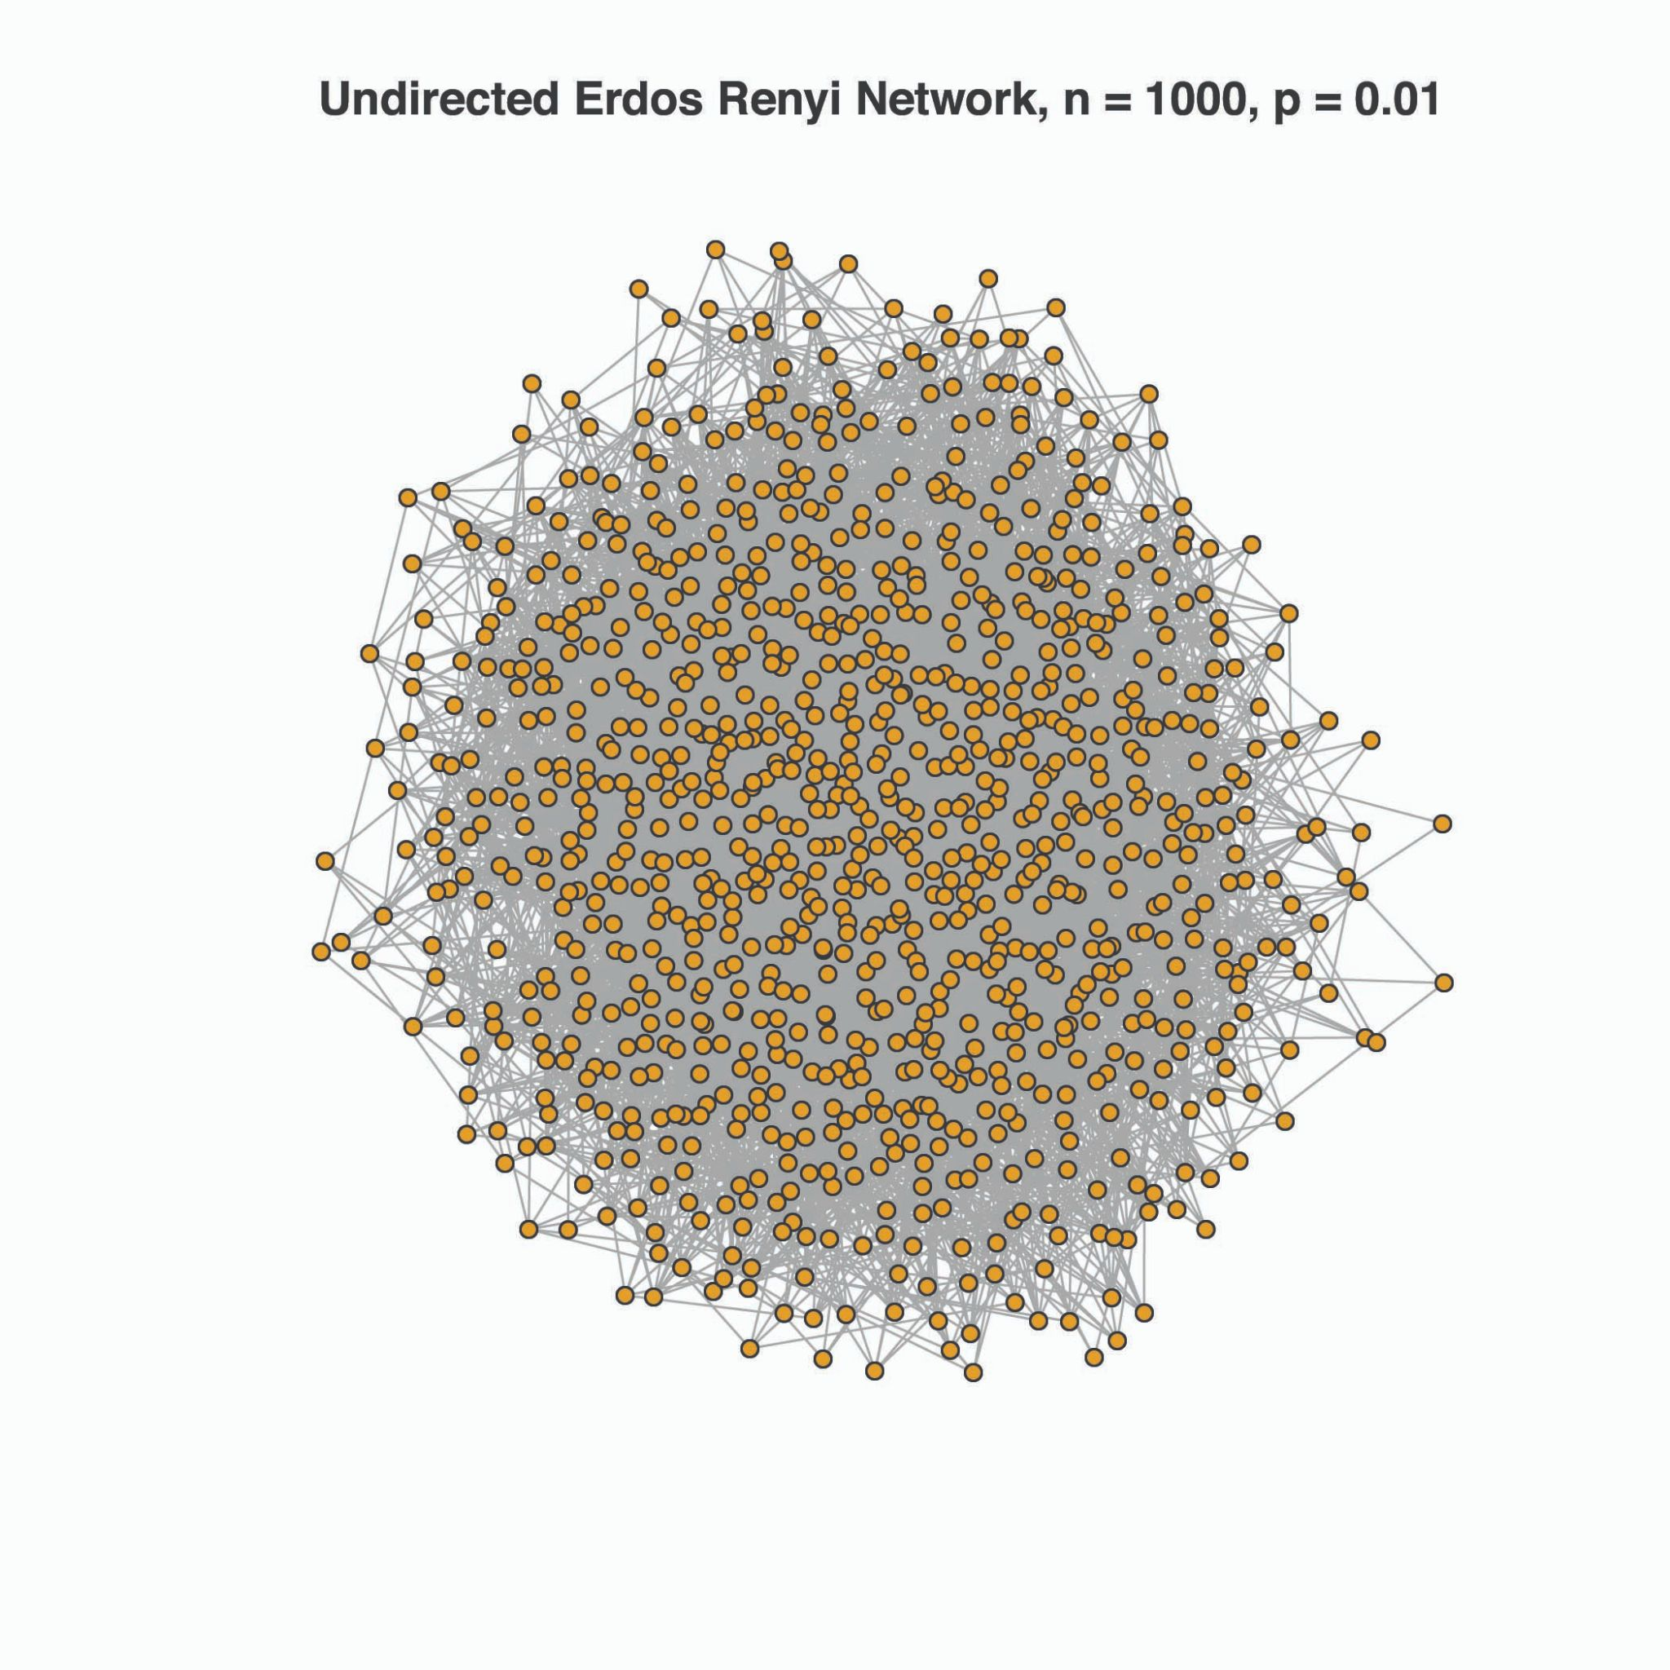
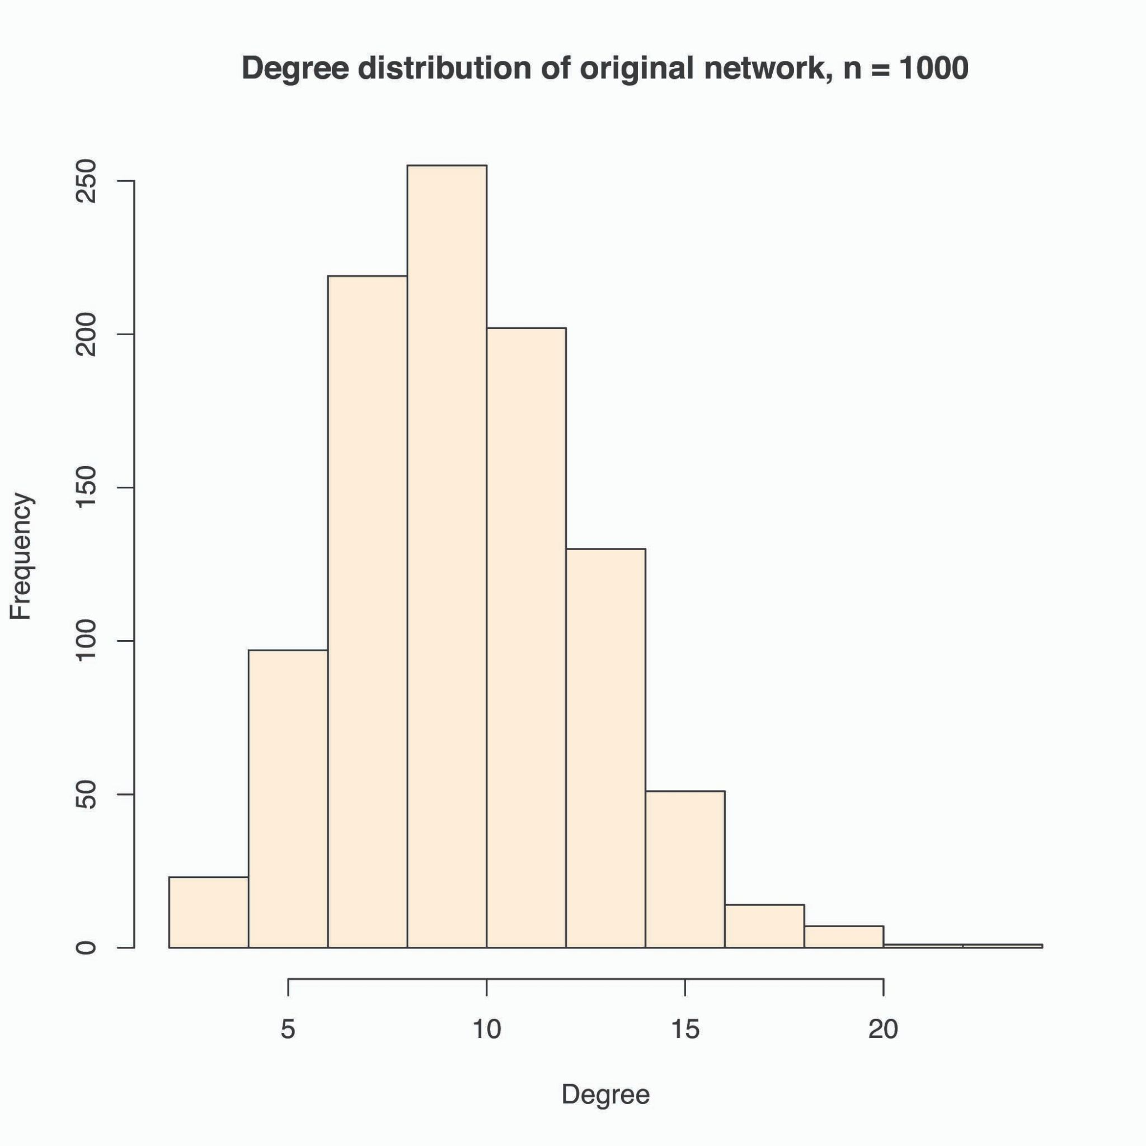
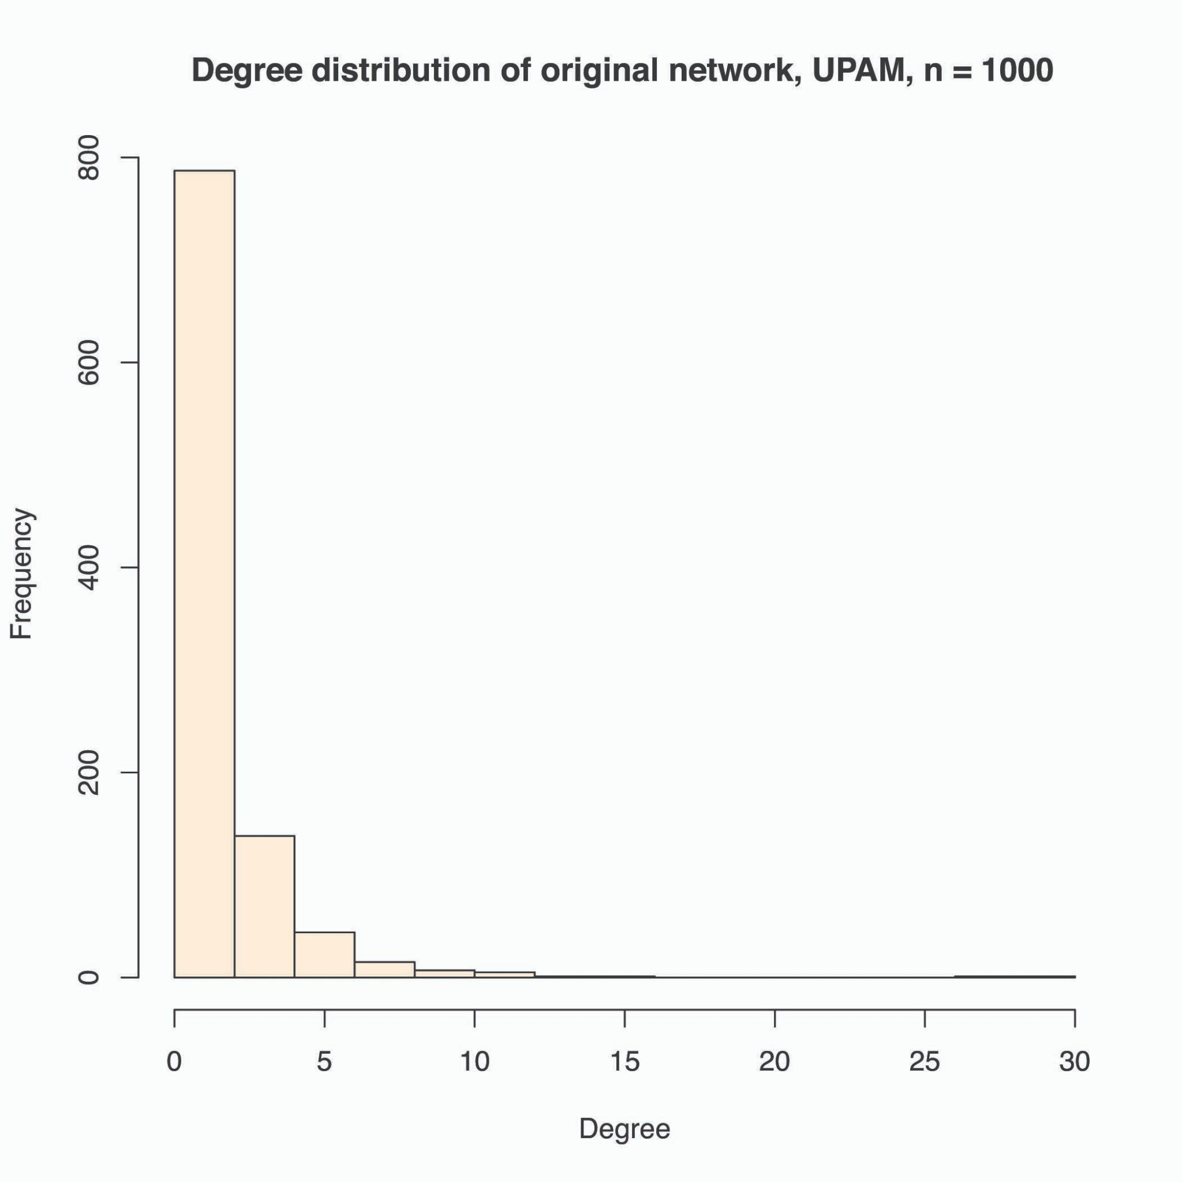
Erdos-Renyi Models
All edges have a certain probability of being present or absent (probability of connectedness).
Network may or may not be fully connected; concept of Giant Connected Component (GCC)
Degree distribution of Erdos-Renyi networks are binomial or Poisson.

Slide 83
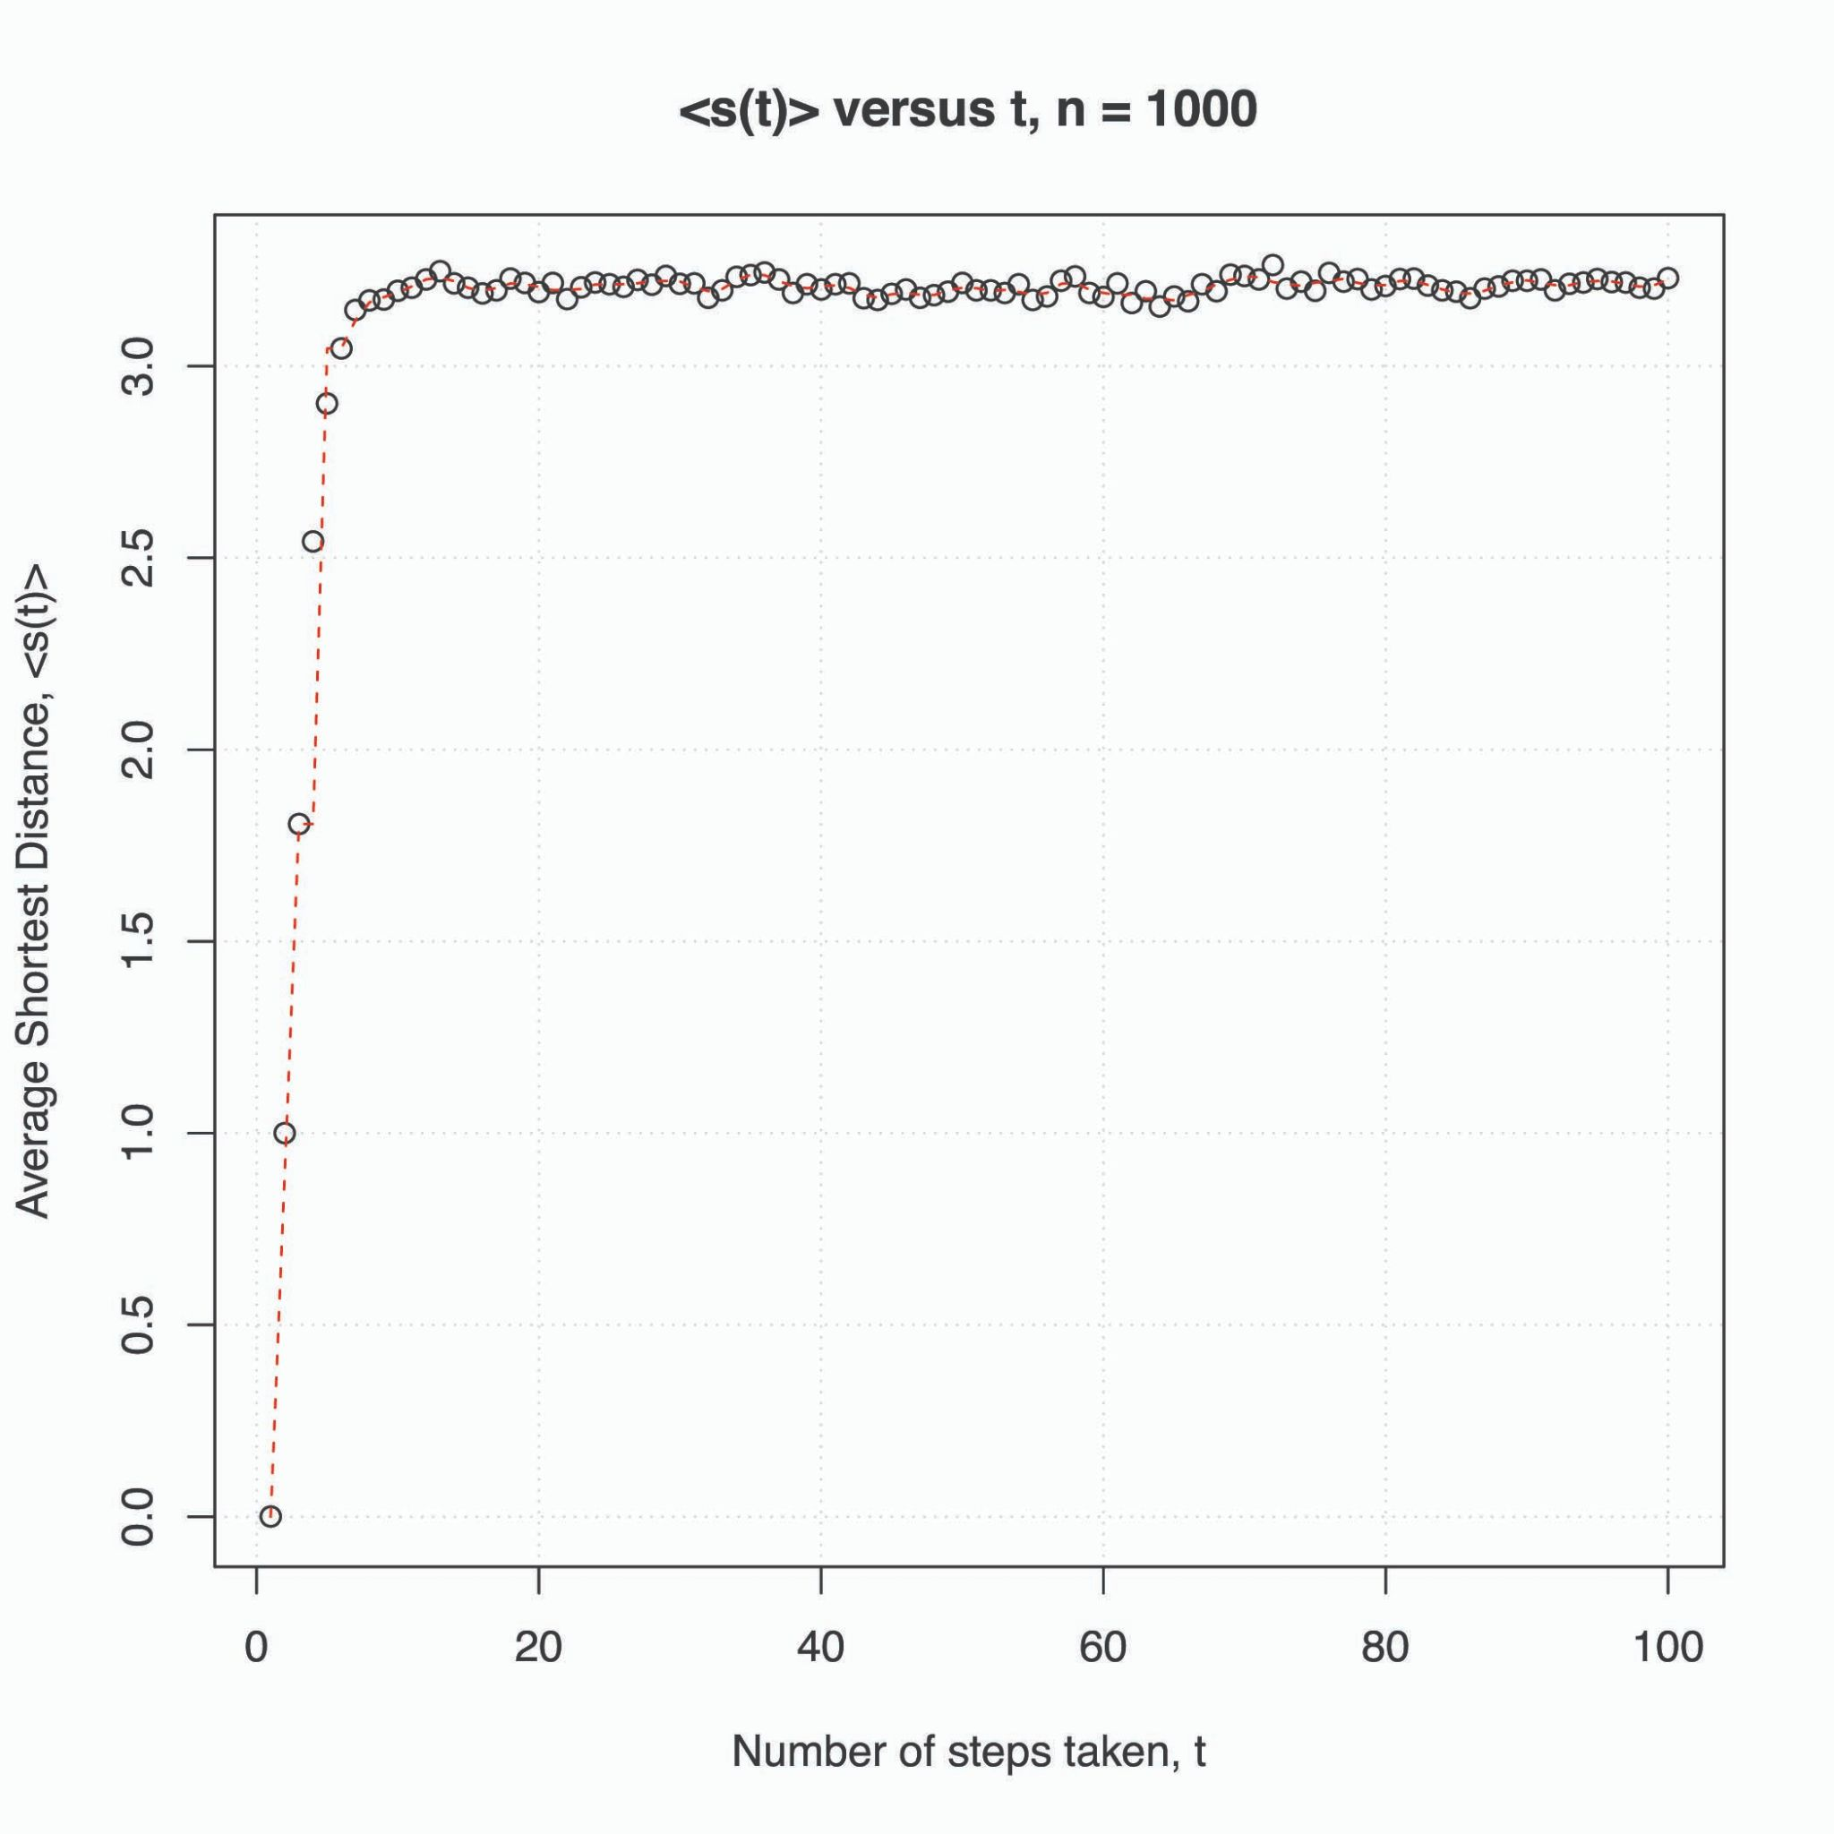
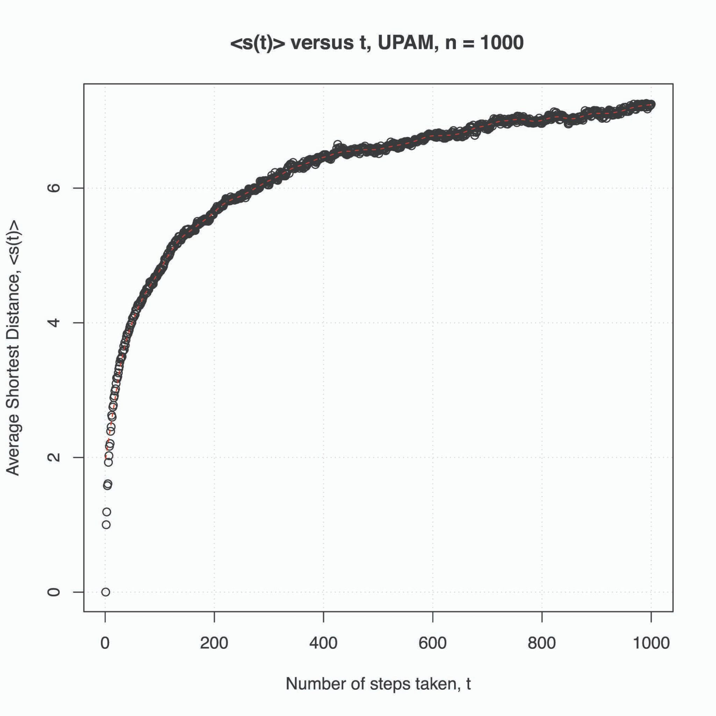
Random Walk on Random Graphs
If you walk randomly on an Erdos-Renyi graph, you will likely end up within a “circular region” corresponding to the average shortest distance of the nodes in the entire network from an initial node.
However, for Barabasi-Albert graphs, your average shortest distance will increase non-monotonically with more steps from the initial node.

Slide 84
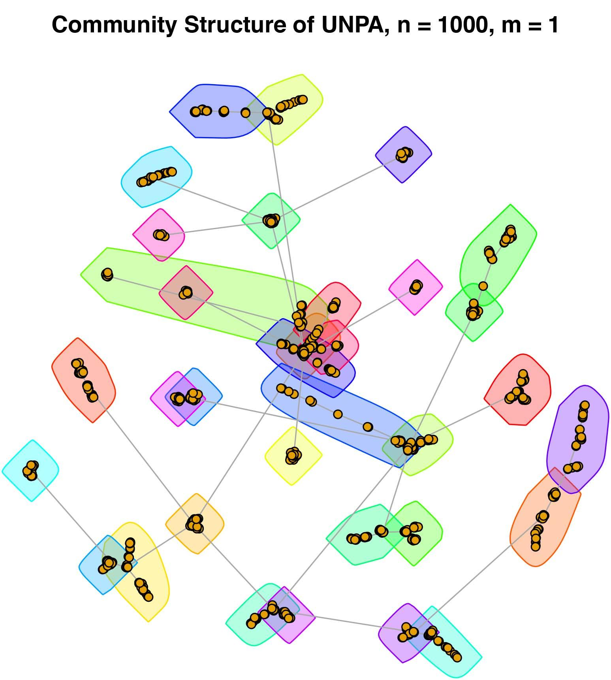
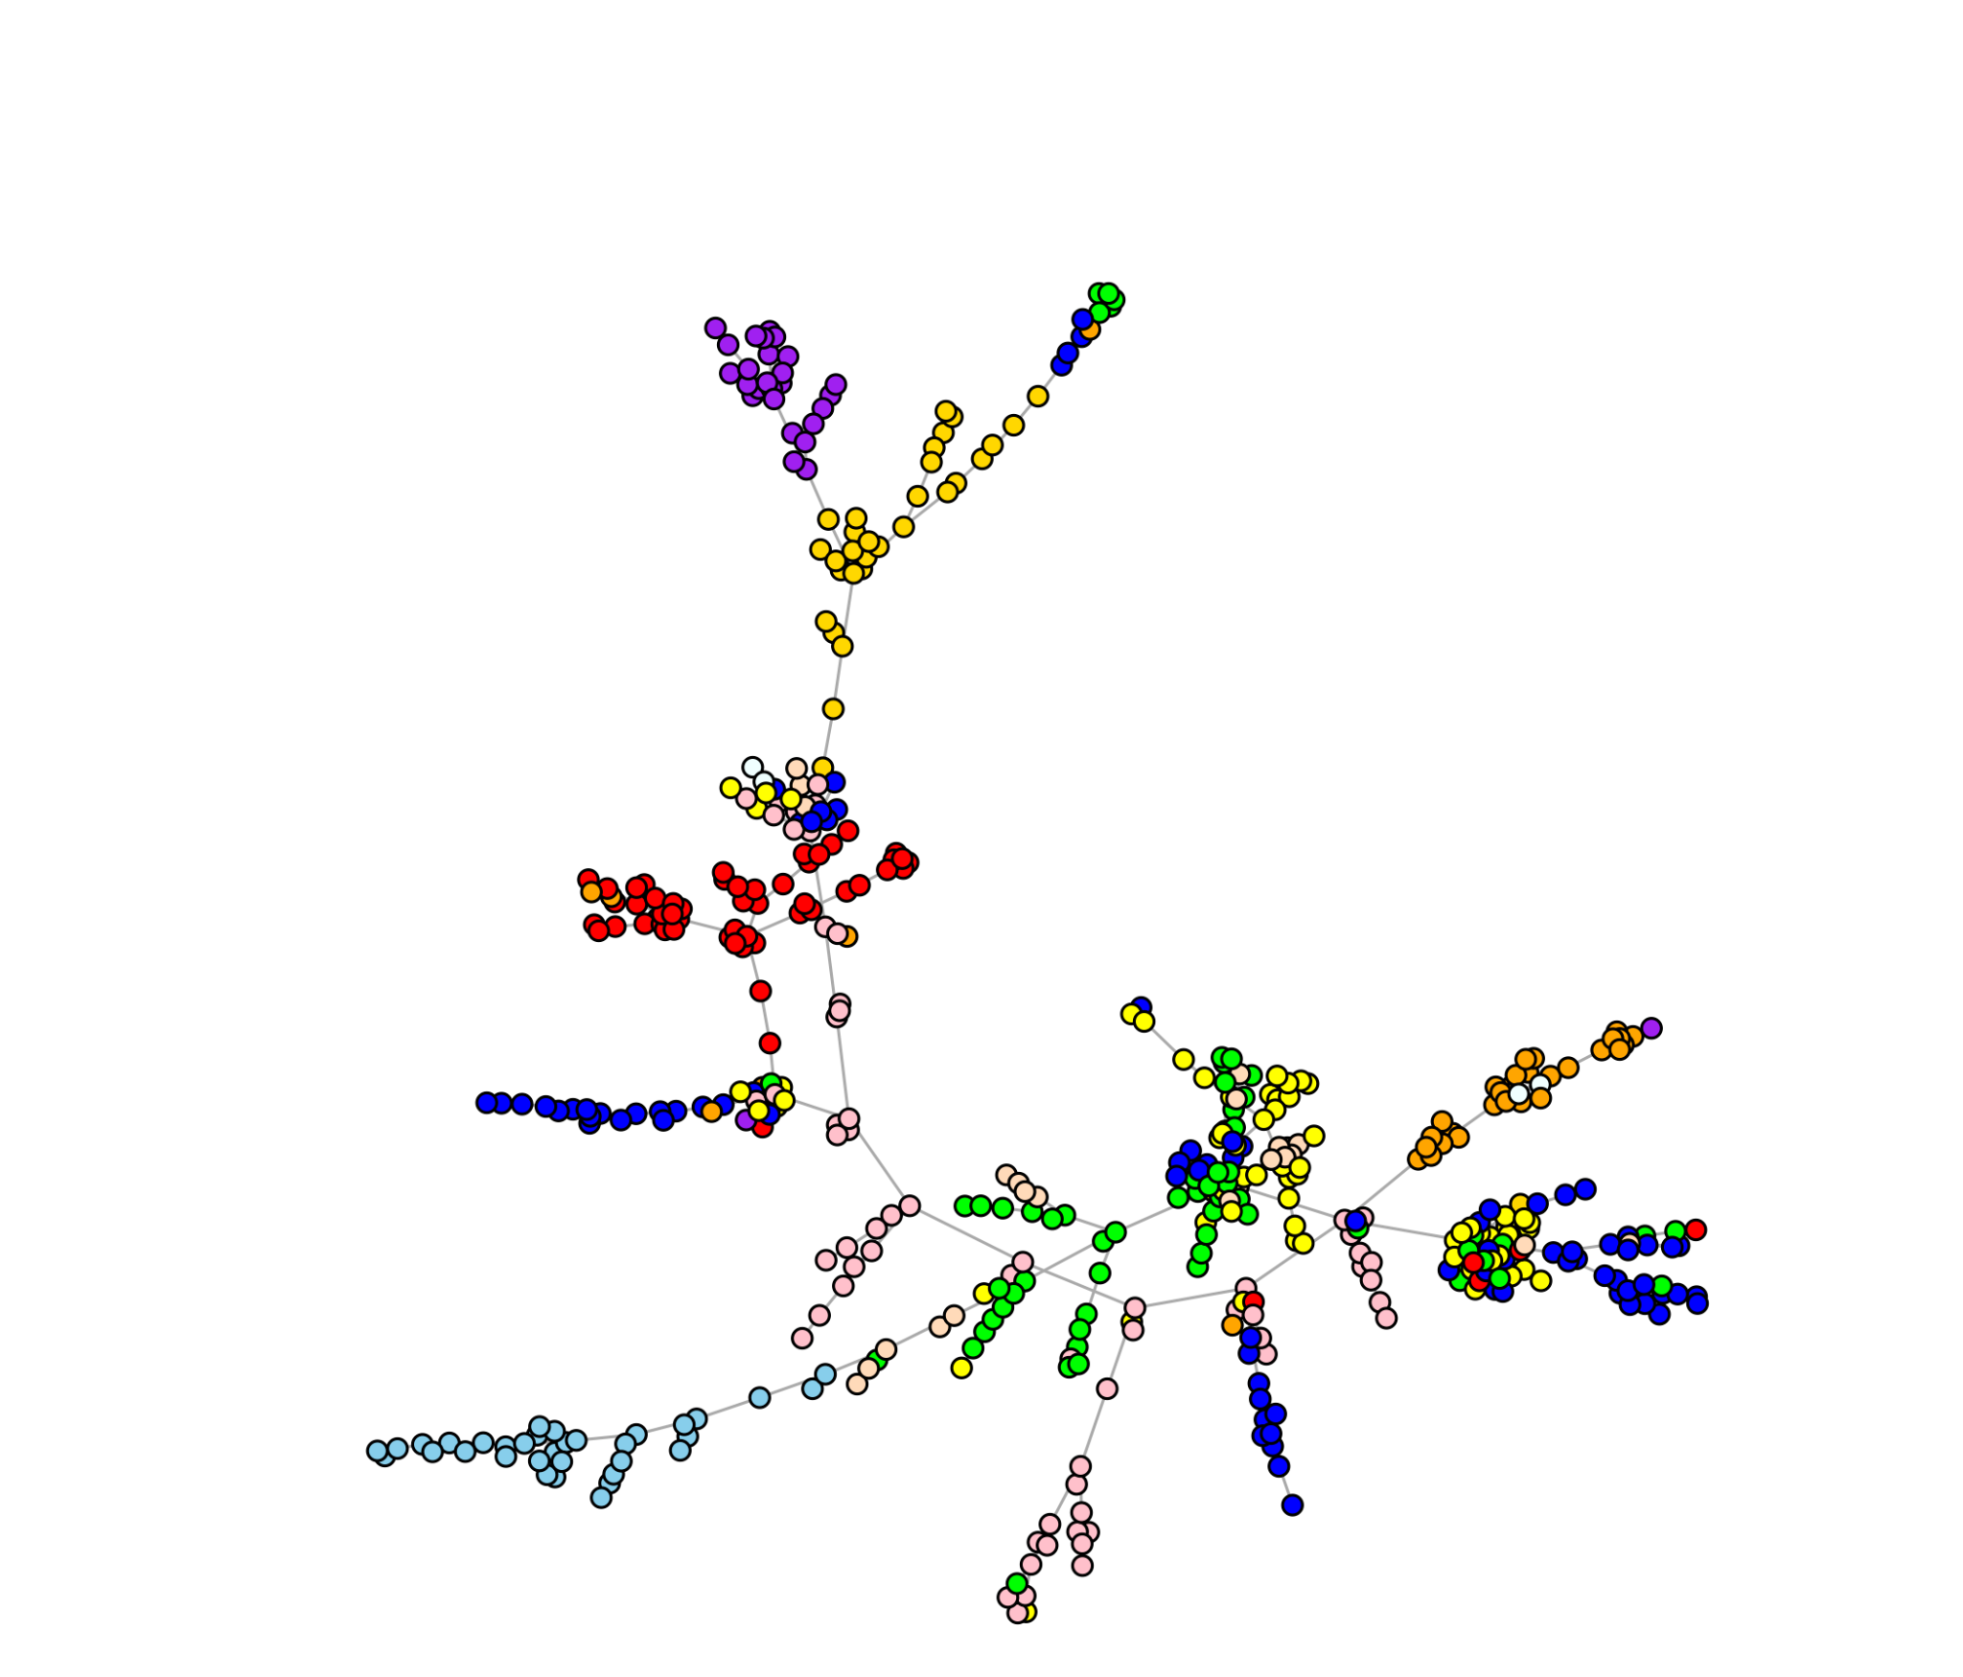
Community Structures and Modularity
Community structures: clusters or regions of high connectedness in the graph
We measure the strength of clustering using modularity score.
Application example: Correlation graph of stocks
Techniques: Fast-Greedy, InfoMap, Edge-Betweenness
Example of stock market correlation graph MST

Slide 85
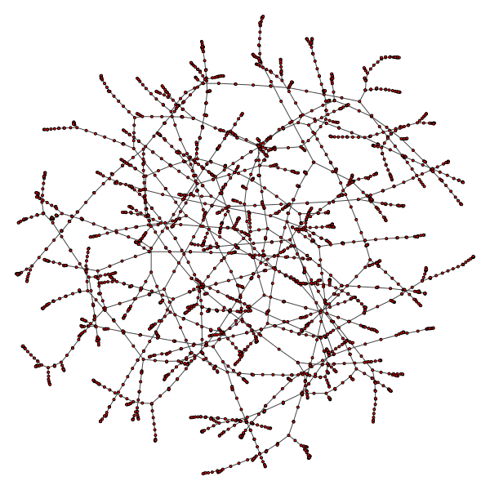
Minimum Spanning Tree (MST)
MST: Connects all the nodes of a connected and edge-weighted undirected graph:
without any cycles
with the lowest possible cumulative edge weights (lowest cost).
Techniques to find MST:
Prim’s Algorithm
Kruskal’s Algorithm
Prim’s Algorithm (uses two sets):
Find a cut
Pick the edge with minimum weight.
Include the edge in the list of included vertices.
MST of Uber Dataset

Slide 86
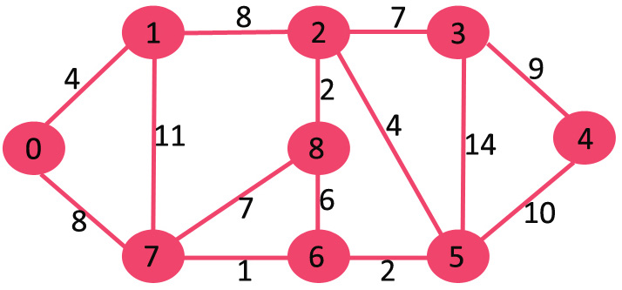
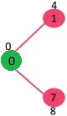




Prim’s Algorithm
https://www.geeksforgeeks.org/prims-minimum-spanning-tree-mst-greedy-algo-5/
Repeat

Slide 87




Dijkstra’s Shortest Path Algorithm
https://medium.com/star-gazers/graph-theory-finding-the-shortest-paths-afb35d28176b

Slide 88


Dijkstra’s Shortest Path Algorithm (contd.)
https://medium.com/star-gazers/graph-theory-finding-the-shortest-paths-afb35d28176b

Slide 89
Prim’s versus Dijkstra's
https://medium.com/star-gazers/graph-theory-finding-the-shortest-paths-afb35d28176b
https://www.baeldung.com/cs/prim-dijkstra-difference
Dijkstra’s algorithm finds the shortest path, but Prim’s algorithm finds the MST.
Dijkstra’s algorithm can work on both directed and undirected graphs, but Prim’s algorithm only works on undirected graphs.
Prim’s algorithm can handle negative edge weights, but Dijkstra’s algorithm may fail to accurately compute distances if at least one negative edge weight exists.
Prim’s Algorithm adds the next vertex that is closest to the tree. Dijkstra’s Algorithm, on the other hand, adds the next vertex that is closest to the root.
Intuitive example:
Dijkstra's: Find shortest and lowest cost path in existing road network.
Prim’s: How to create the road network itself efficiently.

Slide 90

Traveling Salesman Problem (TSP)
Problem formulation: Find the shortest route from a city such that all other cities are visited only once and the traveller returns to the original city.
The triangle inequality: sum of any two sides of a triangle must always be greater than the third side: a + b > c, a + c > b, b + c > a.
The route is also called a Hamiltonian cycle satisfying the triangle inequality
Graph:
Nodes: cities
Edges: Roads
Weights: Distance, travel time, etc.

Slide 91

TSP Intuition
https://towardsdatascience.com/how-to-solve-the-traveling-salesman-problem-a-comparative-analysis-39056a916c9f
TSP is NP-hard: It is not possible to guarantee you will find the shortest path within some predefined time-limit; n cities can have n! paths (nX(n-1)X(n-2)...1), e.g., 15 cities can result in trillion possible routes.
We use approximation techniques to select pareto-optimal routes.

Slide 92

Pre-order traversal
1 - 2 - 4 - 5 - 3

Slide 93


2-approximate algorithm for TSP using MST
https://www.geeksforgeeks.org/travelling-salesman-problem-set-2-approximate-using-mst/
https://www.geeksforgeeks.org/tree-traversals-inorder-preorder-and-postorder/
The cost of the output is never more than twice the cost of best possible output.
Algorithm:
Use Prim’s algorithm to generate MST, using the starting/ending point as the root node.
Find depth-first pre-order traversal of the MST (root, left, right)
Add 1 at the end of the pre-order walk to get the Hamiltonian cycle.
1
4
2
5

Slide 94
Other TSP solutions
Exact algorithms: Dynamic programming
Approximate algorithms:
1-approximate using Eulerian circuits and Dijkstra’s algorithm
2-approximate using MST
Simulated Annealing (guided local search)
Ant-colony Optimization
Special cases
Independent set
2-SAT

